Slide 1
Poster Making Directions
Your poster should be on a single slide, set to the desired dimensions of your final poster (eg. 48” x 36”, which is the maximum size we recommend).
This file contains several templates you can use for your Expo poster. You are not required to use one of these templates; we are providing them to give you ideas. You can find additional poster templates on the internet by searching for “research poster templates.”
Each of these templates is 48” wide x 36” tall; the slides have been set to this size.
Pick a templates and edit it to make it your own! Or combine elements from several of the templates to make yourself a new one.
        Edit the text. Change the titles of each section. Change the colors and fonts.
        Rearrange the content areas to fit your project.
        Add pictures, diagrams, figures, tables, and graphs!
        Be creative!

Slide 2

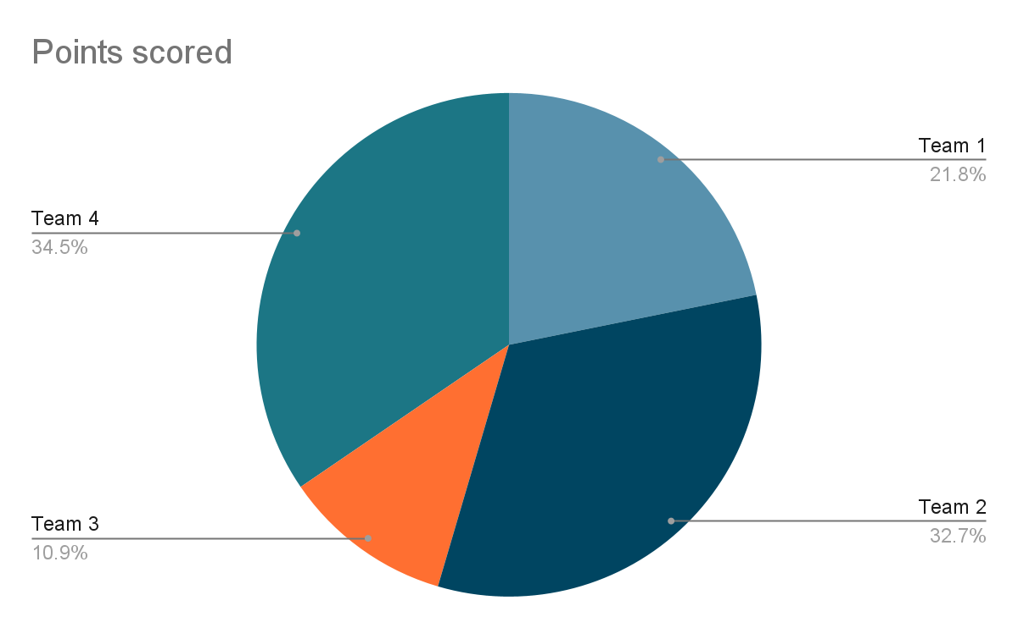
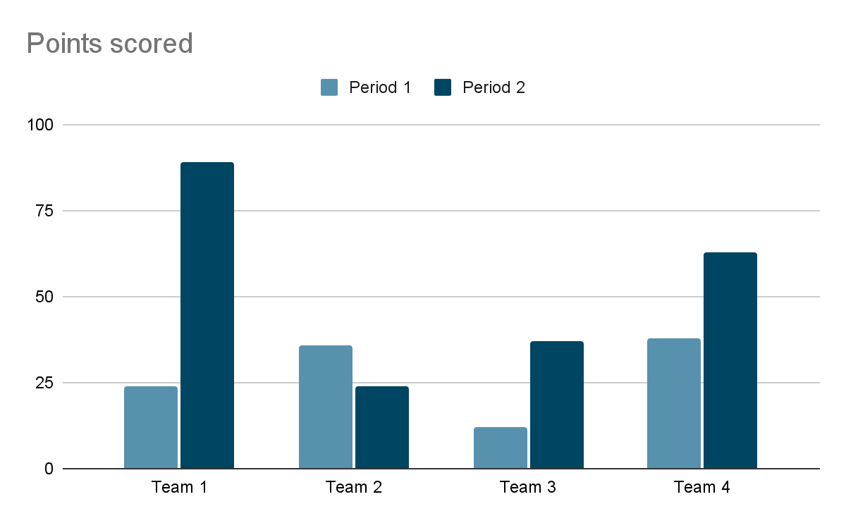


Holidays: Why We Should Have More Vacation Days
Ferris Bueller, Cameron Frye, Sloan Peterson, and Dr. Ed Rooney
Department of Procrastination and Delay Tactics
Bradley University, Peoria, IL 61625
Abstract
Results
School is hard. Vacation is fun. We need to have more vacation days.
What did you find out?
Introduction
What information does your audience need to know to understand your project?
Project Objectives
Discussion
What is the purpose of your project and why is it important?
Analyze your results. What do they mean, what insight do they provide on your project, and how do they relate to your original project goal?
Methods
How did you set up your project, collect your data/information on your topic, and analyze the results?
References
Provide full citations for any references you used.
Acknowledgements
Indicate who helped you with this project and any sources of funding.

Slide 3
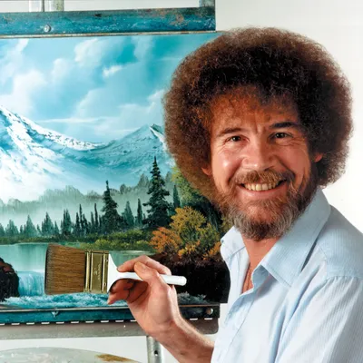
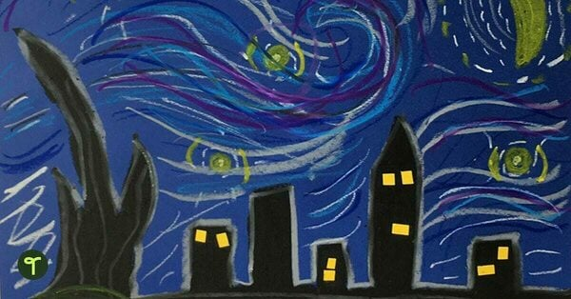
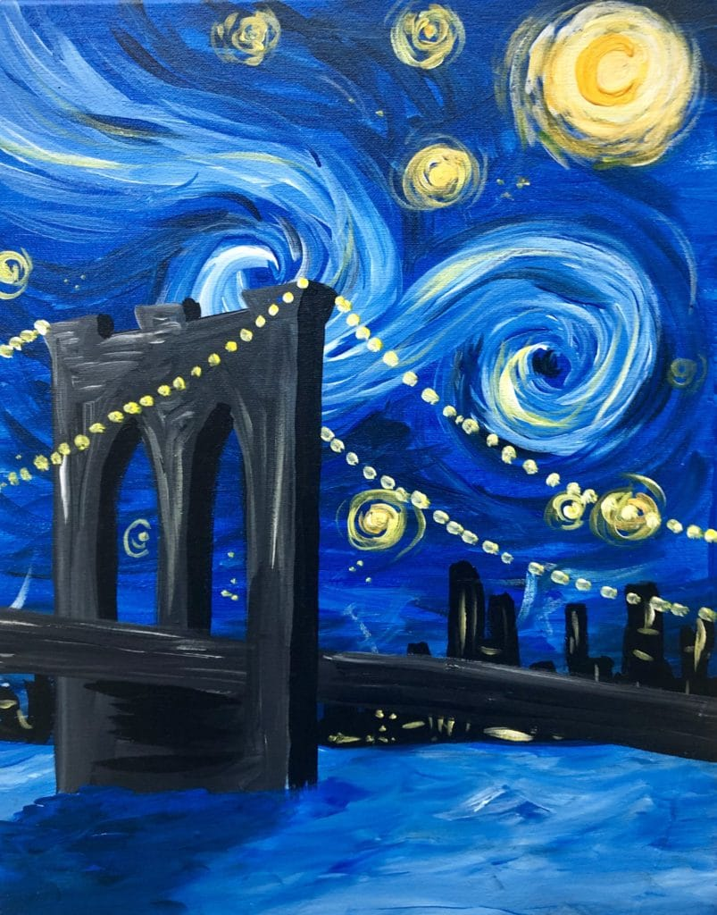
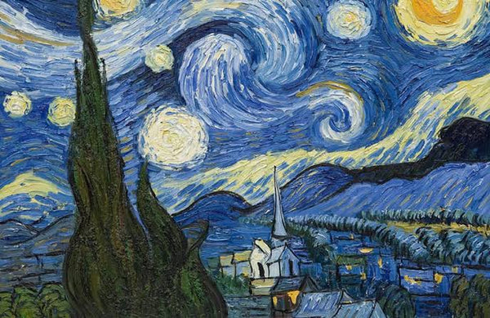
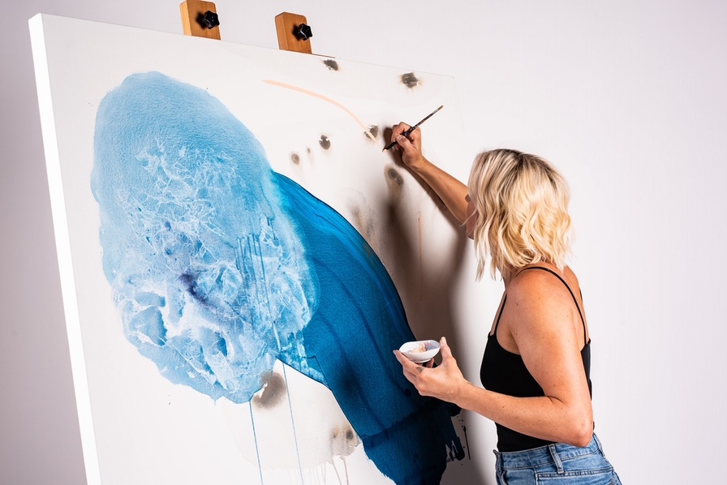

Paint and Canvas: Title of My Artistic Project
Frida Kahlo, Leonardo da Vinci, Edgar Degas, and Professor Crayola
Department of Painting Happy Little Trees
Bradley University, Peoria, IL 61625
Abstract
Artistic Process
I made a really cool artistic piece. It means a lot to me. My inspiration was something important to me. I used paint and canvas to make the piece.
How did you conceive of this project to begin with? How did you make the piece?
Background
What information does your audience need to know to understand your project?
Impact of the Work
What is the impact of this work on either yourself or others? What is original or unique about your work?
Artistic Intent
What is the purpose of your project and why is it important?
Acknowledgements
References
Indicate who helped you with this project and any sources of funding.
Provide full citations for any references you used.

Slide 4

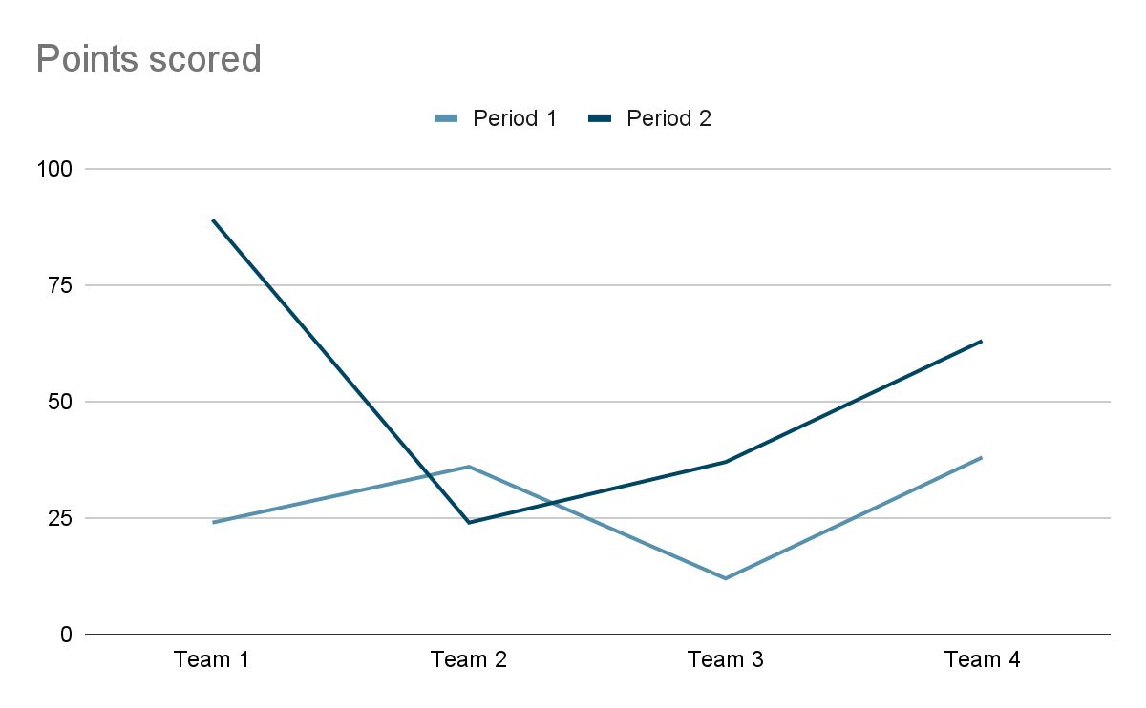
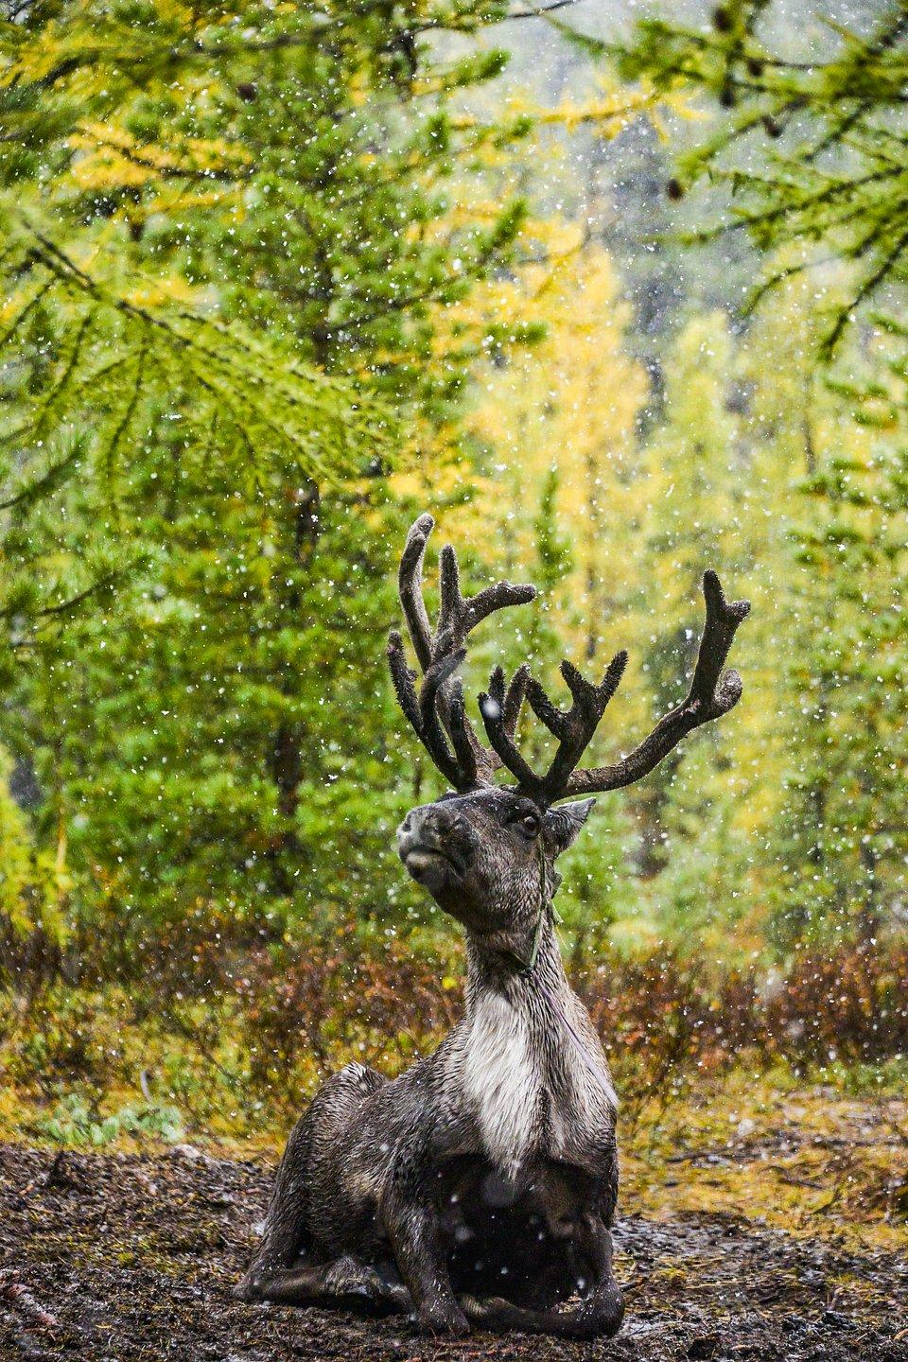
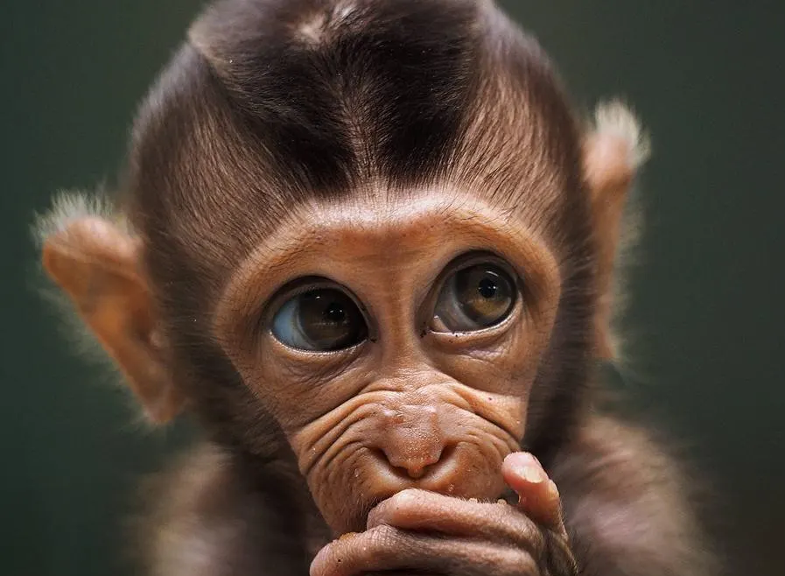
Title of My Really Cool Project about Animals!
Minnie Mouse, Yogi Bear, and Dr. Doolittle
Department of Cute and Funny Animals
Bradley University, Peoria, IL 61625
Abstract
Results
I like animals. This project focuses on animals. I found out some really interesting things on them. I discuss those things on this poster.
What did you find out?
Background Information
What information does your audience need to know to understand your project?
Project Goals and Significance
Conclusions and Future Directions
What is the purpose of your project and why is it important?
Analyze your results. What do they mean, what insight do they provide on your project, and how do they relate to your original project goal?
Methods
How did you set up your project, collect your data/information on your topic, and analyze the results?
References
Provide full citations for any references you used.
Acknowledgements
Indicate who helped you with this project and any sources of funding.

Slide 5
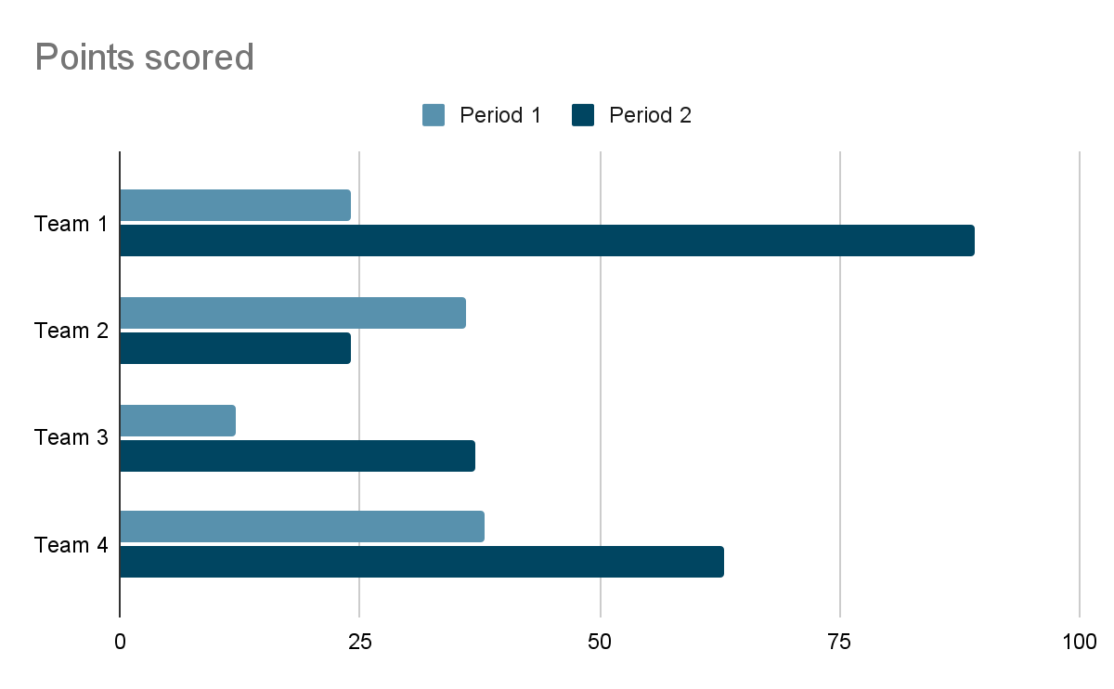

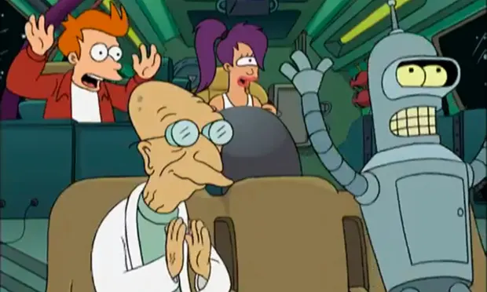
My Fun Study About Cartoons
Phillip Fry, Turanga Leela, and Professor Farnsworth
Department of Saturday Morning Cartoons
Bradley University, Peoria, IL 61625
Abstract
Outcomes
Cartoons are fun. My project focuses on several of my favorite cartoons and the most influential cartoon characters.
What did you find out?
Introduction
What information does your audience need to know to understand your project?
Purpose of the Project
Conclusions
What is the purpose of your project and why is it important?
Analyze your results. What do they mean, what insight do they provide on your project, and how do they relate to your original project goal?
Process
How did you set up your project, collect your data/information on your topic, and analyze the results?
References
Provide full citations for any references you used.
Acknowledgements
Indicate who helped you with this project and any sources of funding.

