Slide 1
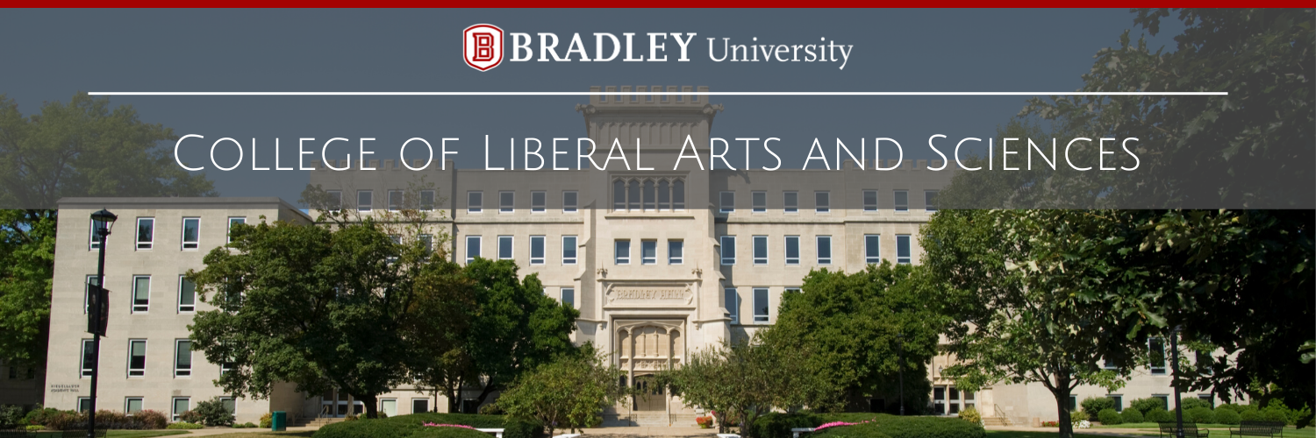
LAS Action Plan 2017-2021

Slide 2
LAS Action Plan 2017-2021
Timeline
  Spring 2016 - Spring 2017: development & ratification
  Fall 2017 - Spring 2020: implementation & tracking
Process
  Department SWOT, faculty survey, forums
Structure
  2 Goals, 28 action items, numerous committees
Notes:
Approved on April 14, 2017 and revised again on November 10, 2017
implementation plan included milestones and metrics where appropriate.
Shout out to Chris Jones, and the 2016-2017 SPC and the exec committee for leading the development of this Action Plan.
Committees go well beyond SPC and Exec, and included a number of task forces, one of which has become a standing committee (MVC) and others that have been working for multiple years with dedicated people.

Slide 3
Goal 1. To enrich the LAS community of scholars, teachers, staff, students, and alumni.
1.1. shared mission, values, and culture; transparency; resource alignment
1.2. student learning; student engagement
1.3. support high quality teaching, RSCA (research, scholarship, creative activity), and community engagement
Notes:
Internal

Slide 4
Goal 2. To work with relevant partners to advance the interests of the College.
2.1. community engagement in support of curriculum, co-curriculum, and scholarship
2.2. engage with internal university partners to enhance support for LAS goals
Notes:
External

Slide 5
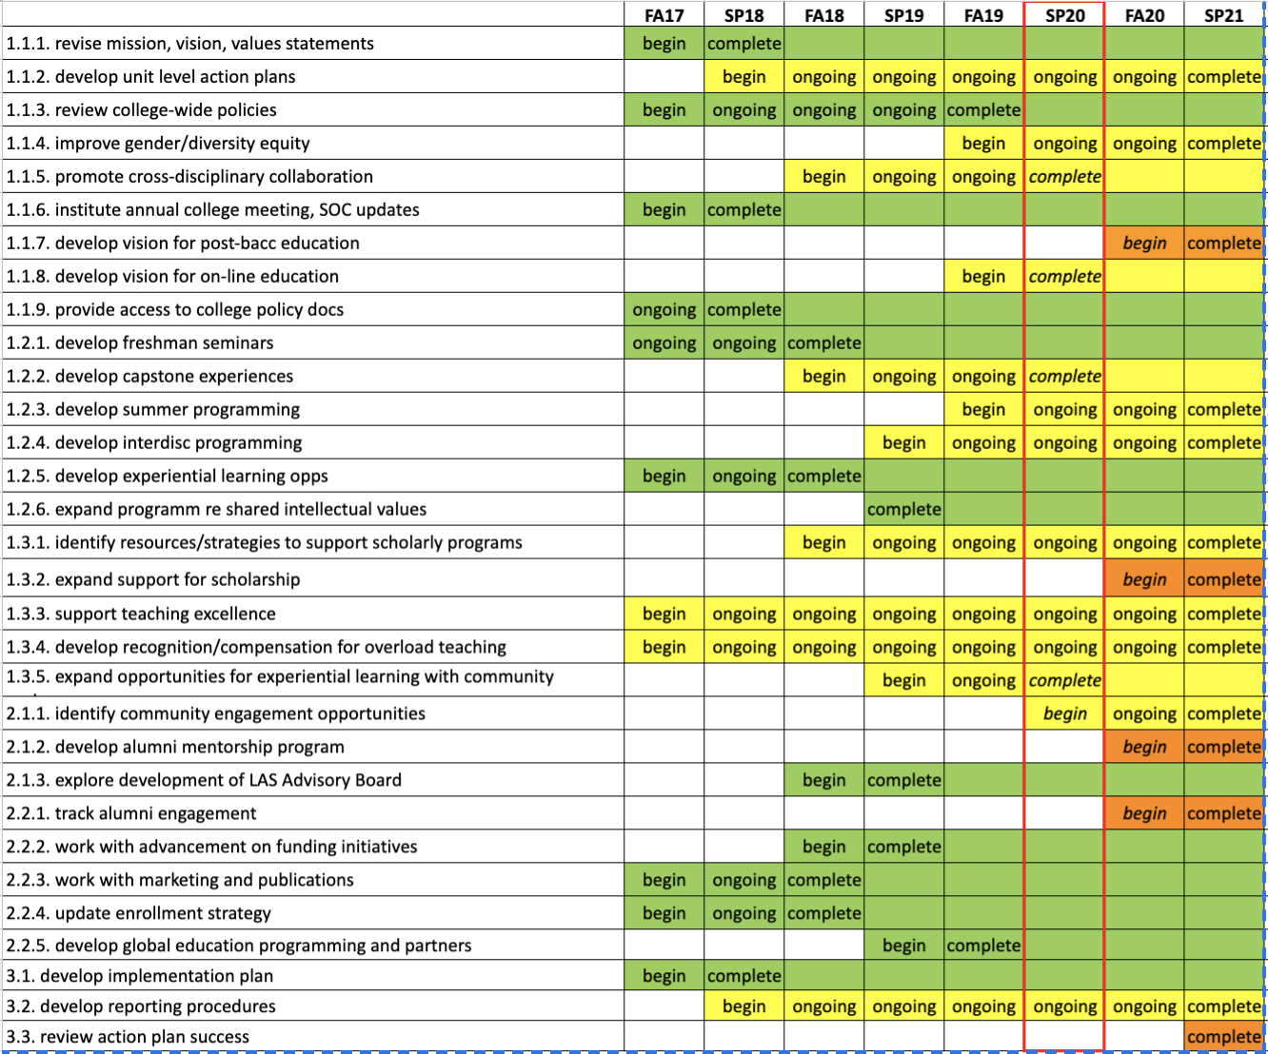
Tracking
progress
Notes:
We tracked progress every semester…..you will also note that the implementation plan actually had staged action items in terms of when we would initiate different elements, and when we expected them to be complete. We adjusted as appropriate. The implementation plan was really a living document, and we iterated.
Green items accomplished
Yellow in progress
orange were to start in FA20….
You may note 31 action items, with three under goal 3. All about tracking progress, making adjustments, reporting and summative review.

Slide 6
What we accomplished...
Culture & Identity
  Mission, LAS Celebration week, lecture series, website revisions
Transparency
  Policies on website, strategic planning process, State of the College address
Liberal Arts & Sciences Education for the 21st Century
  Interdisciplinary learning, global learning, diversity curricula
Engagement
  First-Year Seminar, Summer Research & Artistry, Global Living & Learning community
Notes:
Here is just a taste
some of these were only “done” in as much as items were limited in scope for this initial action plan.

Slide 7
More accomplishments...
Support
  Capital equipment, pre-tenure release policy, travel policy
  Teaching, scholarship, & service awards, progress on workload
Equity
  LAS leaders on key university committees
  Progress on articulating “equity roadmap”
  Model for college-wide workload balancing and performance evaluation
Recruitment
  Enrollment management strategy
Notes:
you might notice that we made good progress on those items that LAS had more control over...

Slide 8
What is in progress...
Securing new revenue streams and resources
Inclusive and equitable practices
Workload models
Community partnerships
Alumni engagement
Vision for post-bacc education
Vision for online education

Slide 9
What impeded progress?
External constraints (beyond BU control)
  Covid, devaluation of higher ed, demographic “cliff”
External constraints (beyond LAS control)
  University finances, current budgeting/workload/T&P models
Items that need reallocation of energies or money
  Community partnerships, alumni engagement
Complex issues that are hard to talk about
  Diversity/equity/inclusion, workload

Slide 10
What should be in new strategic plan(s)?
Diversity, equity, and inclusion
Workload
Online education opportunities
Revenue streams
Signature programs (e.g., First Year Seminar)
Promote, support, and expand Experiential Learning in LAS
Develop a college vision statement
Support for research, scholarship, and creative activity (RSCA)
Notes:
The SPC feels that these are the enduring concerns that we need to continue chipping away at, or initiates that are worth continuing to nurture/expand

Slide 11
LAS Strategic Planning Committee (Spring ‘22)
Danielle Glassmeyer (Humanities)
Aurea Toxqui (Humanities)
Melinda Faulkner (Natural & Computational Sciences/Math)
Jose Lozano (Natural & Computational Sciences/Math)
Amy Bacon (Social Sciences)
Tim Keltzow (Social Sciences)
Pat Campbell (Supervisor of Administration)
Michelle Edgcomb Friday (Int. Associate Dean Curric. & Assessment)
Dan Moon (Dean)

