Slide 1
Building Learning Communities Through Engaged Learning
Dr. Heljä Antola Crowe
Bradley University

Slide 2
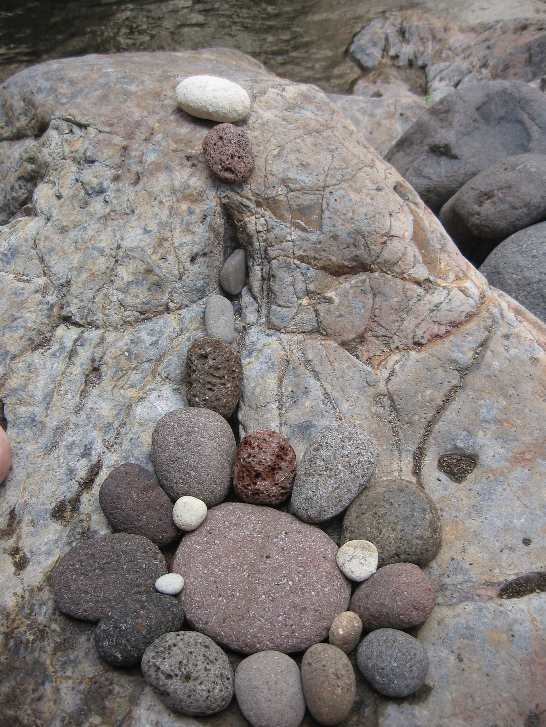
Complexity and beauty-possibilizing growth

Slide 3
Quotes
“We teach who we are” (Parker Palmer)
https://vimeo.com/155179699
Today is an invitation to think out loud together
Invitational and collaborative discussions
Lassi Nummi:
Again and again we ask
Who are we?
Others will tell you what we look like
Who we are is what we must know ourselves

Slide 4
Session Goals
I. Articulate the importance of communicative rapport building with students and colleagues in creating learning communities.
II. Create and carry out meaningful, engaged learning activities to support physical, intellectual and social-emotional learning while meeting standards-based expectations.
III. Develop a deeper understanding of the importance of reflective practice as a professional in order to support students’ optimal learning.

Slide 5
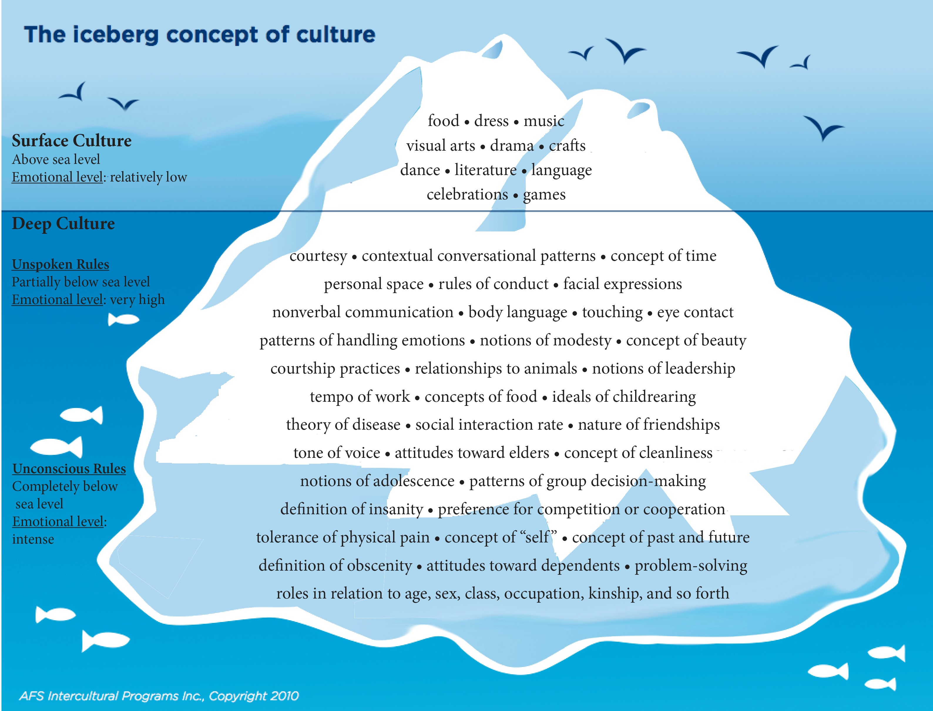
Culture is of essence in learning communities

Slide 6
Bradley Learning community:
Nested Learning communities
How are we building our learning community?
Bradley Core Curriculum work
Scholarship of Teaching and Learning
Teaching Forums
Graduations, celebrations
Informal encounters

Slide 7
Cross-Cultural Competencies
Cultural Destructiveness: Seeing the difference, stomping it out. The elimination of other people’s cultures
Cultural incapacity: See the difference, make it wrong. Belief in the superiority of one’s own culture
Cultural blindness: See the difference, act like you don’t. Acting as if the cultural differences you see do not matter of not recognizing that there are differences among and between cultures

Slide 8
Cross-Cultural Competencies…
Cultural precompetence: See the difference, respond inadequately.
Cultural competence: See the difference understand the difference that difference makes.
Cultural proficiency: See the difference and respond effectively in an variety of environments. Holding esteem for culture; knowing how to learn about individual and organizational culture; interacting effectively in a variety of cultural environments. Lindsey et al. (2003)

Slide 9
Allophilia – Liking, love of the other
Affection
Comfort
Engagement
Enthusiasm
Kinship
Pittinsky, T. L. (2005). Allophilia and intergroup leadership. Retrieved from http://papers.ssrn.com/sol3/papers.cfm?abstract_id=739705

Slide 10
Languages spoken in the U.S.
Abnaki, Achinese, Achumawi, African, Afrikaans, Ahtena, Alabama, Albanian, Aleut, Algonquian, American Indian, Amharic, Apache, Arabic, Arapaho, Arawakian, Arikara, Armenian, Assamese, Athapascan, Atsina, Atsugewi, Aymara, Azerabaijani, Aztecan, Balinese, Balochi, Bantu, Basque, Bengali, Berber, Bielorussian, Bihari, Bikol, Bisayan, Blackfoot, Bulgarian, Burmese, Caddo, Cahuilla, Cajun, Cambodian, Cantonese, Carolinian, Catalonian, Caucasian, Cayuga, Chadic, Cham, Chamorro, Chasta Costa, Chemehuevi, Cherokee, Chetemacha, Cheyenne, Chibchan, Chinese, Chinook Jargon, Chiricahua, Chiwere, Choctaw, Chumash, Clallam, Cocomaricopa, Coeur D'alene, Columbia, Comanche, Cowlitz, Cree, Croatian, Crow, Cupeno, Cushite, Czech, Dakota, Danish, Delaware, Delta River Yuman, Diegueno, Dravidian, Dutch, Efik, Eskimo, Estonian, Faroese, Fijian, Finnish, Foothill North Yokuts, Formosan, Fox, French, French Cree, French Creole, Frisian, Fuchow, Fulani, German, Gilbertese, Gondi, Greek, Gujarati, Gullah, Gur, Haida, Hakka, Havasupai, Hawaiian, Hawaiian Pidgin, Hebrew, Hidatsa, Hindi, Hmong, Hopi, Hungarian, Hupa, Icelandic, Ilocano, India n.e.c.2, Indonesian, Ingalit, Inupik, Irish Gaelic, Iroquois, Italian, Jamaican Creole, Japanese, Javanese, Jicarilla, Kachin, Kan, Hsiang, Kannada, Kansa, Karachay, Karen, Karok, Kashmiri, Kazakh, Keres, Khoisan, Kickapoo, Kiowa, Kirghiz, Klamath, Koasati, Korean, Koyukon, Krio, Kru, Ibo, Yoruba, Kuchin, Kurdish, Kusaiean, Kutenai, Kwakiutl, Ladino, Laotian, Lapp, Lettish, Lithuanian, Luiseno, Lusatian, Luxembourgian, Macedonian, Makah, Malagasy, Malay, Malayalam, Mandan, Mandarin, Mande, Maori, Mapuche, Marathi, Marquesan, Marshallese, Mayan languages, Mbum, Melanesian, Menomini, Miami, Miao-yao, Mien, Micmac, Micronesian, Mikasuki, Misumalpan, Mohave, Mohawk, Mokilese, Mon-Khmer, Mongolian, Mono, Mortlockese, Mountain Maidu, Munda, Muskogee, Navajo, Nepali, Nez Perce, Nilo-hamitic, Nilotic, Niuean, Nomlaki, Nootka, Northern Paiute, Northwest Maidu, Norwegian, Nubian, Nukuoro, Ojibwa, Okanogan, Omaha, Oneida, Onondaga, Oriya, Osage, Other Uralic languages, Oto – Manguen, Ottawa, Pacific Gulf Yupik, Paiute, Pakistan n.e.c. 2, Palau, Paleo-siberian, Pampangan, Pangasinan, Panjabi, Papia Mentae, Pashto, Passamaquoddy, Patois, Pawnee, Pennsylvania Dutch, Penobscot, Persian, Pidgin, Pima, Polish, Polynesian, Pomo, Ponapean, Ponca, Portuguese, Potawatomi, Puget Sound Salish, Quechua, Quinault, Rajasthani, Rarotongan, Rhaeto-romanic, Romanian, Romany, Russian, Sahaptian, Saharan, Salish, Samoan, Santiam, Saramacca, Scottic Gaelic, Sebuano, Seneca, Serbian, Serbocroatian, Serrano, Shawnee, Shoshoni, Sierra Miwok, Sindhi, Sinhalese, Siuslaw, Slovak, Slovene, Sonoran, Spanish, Spokane, St Lawrence Island Yupik, Sudanic, Swahili, Swedish, Syriac, Tachi, Tadzhik, Tagalog, Tamil, Tanaina, Tarascan, Telugu, Tewa, Thai, Tibetan, Tiwa, Tlingit, Tokelauan, Tongan, Tonkawa, Towa, Trukese, Tsimshian, Tungus, Tupi-guarani, Turkish, Turkmen, Tuscarora, Uighur, Ukrainian, Ulithean, Upper Chinook, Urdu, Ute, Vietnamese, Walapai, Washo, Welsh, Wichita, Winnebago, Wintun, Woleai-ulithi, Wu, Yapese, Yaqui, Yavapai, Yiddish, Yuchi, Yuma, Yupik, Yurok, Zuni

Slide 11
Thousand ways of teaching and learning
Fill out handout questions #1 and #2

Slide 12
Perspective-taking exercise
Quickly draw what you see in the middle of the room from where you are sitting.
Look at the different sketches. What do you notice?
Imagine, that the artifacts you drew represent students in your classroom or colleagues in your workplace.
Some individuals are invisible from where you are.
If not aware of different perspectives, a gifted, suffering or a challenged student might be invisible to us.
To build a complete picture, we must be willing to move ourselves.

Slide 13
Collaboration
At your tables, please function as a team and build the tallest tower
Communicate in silence nonverbally throughout your experience.
Discuss the process, the roles people took and inner messaging while in the exercise

Slide 14
Influence of total of communication in our communications
Verbal communication; message, content, information: 7%
Tonality, volume, tempo, resonance, projection, intonation, frequency, fluency: 38%
Nonverbals such as facial expression, eye contact, gestures, posture, mannerisms, body action, distance, movement: 55%
Cushner et al. (2016).

Slide 15
Understanding understanding
1. We can explain: provide thorough, supported, justifiable accounts of phenomena, fact and data. Besides facts we know why and how things happened and looks at relationships. (Showing student’s work)
Why is that so? What explains such events? What accounts for such action? How can we prove it? To what is this connected? How does this work? What is implied?
2. We can interpret: tell meaningful stories; offer apt translations; provide revealing historical or personal dimensions to ideas and events; make it personal or accessible through anecdotes, images and models.
What does it mean? Why does it matter? What of it? What does it illustrate or illuminate in human experience? How does it relate to me? What makes sense?

Slide 16
Understanding…
3. We can apply: effectively use and adapt what we know in diverse contexts.
How and where can we use this knowledge, skills, process? How should my thinking and action be changed to meet the demands of this situation?
4. We have perspective: see and hear points of view through critical and insightful eyes and ears; see the big picture.
From whose point of view? What is assumed that needs to be made explicit and considered? What is justified and warranted? Is there adequate evidence? Is it reasonable? What are the strengths and weaknesses of the idea? Is it plausible?
\

Slide 17
Understanding…
5. We can empathize: find value in what others might find odd, alien, or implausible; perceive sensitively on the bases of prior direct experience; rethink; see from multiple points of view.
How does it seem to you? What do they see that I don’t? What do I need to experience if I am to understand? What was the presenter, doctor, artist or performer seeing, and trying to make me feel and see?
6. We have self-knowledge: perceive the personal style, prejudices, projections, and habits that shape and limit our own understanding; we are aware of what we don’t understand and why understanding is so hard; we are aware of how we think and why.
How does who I am shape my views? What are the limits of my understanding? What are my blind spots? What am I prone to misunderstand because of experience, habit, style or prejudice?
From Wiggins, G. & McTighe (2005). Understanding by design. Alexandria: Virginia. Association for the Supervision and Curriculum Development.

Slide 18
Learning about learning= Metalearning, Metacognition
“The process by which learners become aware of and increasingly in control of habits of perception, inquiry, learning, and growth that they have internalized.” (Maudsley, 1979)
“Being aware of and taking control of one’s own learning.” (Biggs, 1985)
To develop, identify and practice personal meta-learning approaches: forms of observation, reflection, self-talk, and collegiality (Cross, 2006).

Slide 19
Social-emotional learning
Goal 1: Develop self-awareness and self-management skills to achieve school and life success.
A. Identify and manage one’s emotions and behavior.
B. Recognize personal qualities and external supports.
C. Demonstrate skills related to achieving personal and academic goals
Goal 2: Use social-awareness and interpersonal skills to establish and maintain positive relationships
A. Recognize the feelings and perspectives of others.
B. Recognize individual and group similarities and differences.
C. Use communication and social skills to interact effectively with others. D. Demonstrate an ability to prevent, manage, and resolve interpersonal conflicts in constructive ways.
Goal 3: Demonstrate decision-making skills and responsible behaviors in personal, school, and community contexts.
A. Consider ethical, safety, and societal factors in making decisions.
B. Apply decision-making skills to deal responsibly with daily academic and social situations.
C. Contribute to the well-being of one’s school and community.
https://www.casel.org/wp-content/uploads/2016/08/PDF-7-Illinois-SEL-Standards.pdf

Slide 20
Positive Work
Environment
Safe and Supportive
Environment
Challenging
Curriculum
High Expectations
Respectful, caring
relationships
Social and
Emotional Skills
Self-awareness
Self-management
Social awareness
Relationship skills
Responsible
Decision making
Student
Outcomes
Academic success
Good relationships
Good health
Engaged citizens
CASEL, the Collaborative for Academic, Social, and Emotional Learning
+
=

Slide 21
Brain/Mind learning principles
Caine et al. (2009) emphasize that keeping in mind the brain in teaching, we support the learning of all students.
1. The brain is a parallel processor.
2. Learning engages the entire physiology.
3. The search for meaning is innate.
4. The search for meaning occurs through "patterning."
5. Emotions are critical to patterning.
6. Every brain simultaneously perceives and creates parts and wholes.

Slide 22
7. Learning involves both focused attention and peripheral perception.
8. Learning always involves conscious and unconscious processes.
9. We have (at least) two types of memory systems: spatial and rote learning.
10. The brain understands and remembers best when facts and skills are embedded in natural spatial memory.
11. Learning is enhanced by challenge and inhibited by threat.
12. Every brain is unique.

Slide 23
WHAT OF MEANING?
Perodoxicol
It is important to know about Perodoxicol
Perodoxicol is a form of zionter. It is montilled in Ceristanna. The montillation process lukisizes, tredipitates and polarizes fibers in the base of the prolongating memis non strata. For its qualities as the bracterizer of molecular helixes, Perodoxicol holds great hopes for the future in our profession.

Slide 24
Test questions:
1. What is Perodoxicol?
2. Where is it montilled?
3. What does the montillation process do in the memis non strata?
4. What qualities make Perodoxicol
important in the future?
Notes:
Emotions are always present in learning, Take a test

Slide 25
LISTENING
Active listening, which involves paraphrasing or interpreting the heard communication
Passive listening, no talking but eye-contact and other nonverbal signs that signify listening
Inattentive listening – no attempt to respond, listener continues own activity, such as reading
Pretend listening – maintaining false nonverbal signs while the person is thinking about something else

Slide 26
LISTENING
Conversational listening – talking and responding is expected and encouraged
Argumentative listening; looking for flaws in talker’s verbal communication
Informational listening; listening with a purpose of extracting certain information
Constructivist listening: listener communicates interest, caring and acceptance. Constructivist listening includes both cognitive and affective processing in interaction
Weissglass, J. (1990) Constructivist listening for empowerment and change. The Educational Forum 54(4), 351-370

Slide 27
Faculty and Staff as Reflective Practitioners
Who am I as a cultural being?
How do I support our students in the context of their individual cultural, experiential background?
What are the strengths of my personality that empower students and colleagues in my workplace?
Strengths exercise

Slide 28
*Stress – Resilience – Self-care
Stress causes $300 billion loss in productivity in the U.S. annually (Accidents, Absenteeism, Employee turnover, Diminished productivity, Direct medical, legal, and insurance costs, Workers’ compensation awards as well as tort and FELA judgments https://www.stress.org/workplace-stress/ )
Effects of prolonged stress can lead to problems in several areas:
Body : Headache, back pain, decreased immunity, chest pain, Heart disease, heart palpitations, high blood pressure, stomach upset, sleep problems
Thoughts and feelings .. anxiety, restlessness, worrying, irritability, depression, sadness, anger, feeling insecure, lack of focus, burnout, forgetfulness
Behavior Over- or undereating, angry outbursts, drug or alcohol abuse, crying, increased smoking, social withdrawal, relationship conflicts, http://www.mayoclinic.com/health/stress-symptoms

Slide 29
Empowerment orientation:
Person-centered community and culture
Working together supports the building of strength and ability to take charge of one’s own life:
What am I like? (Self-concept)
Who am I and where do I belong? (Self-identity)
Am I of value and a good person (Self-appreciation)
Do I feel confident about my value and competencies (Self-trust)

Slide 30
Characteristics of Global Competence
Initiative • Enthusiasm • Inquisitiveness • Interest in continuous learning • Courage • Self-reliance • Self-confidence • Self-control • Self-knowledge • Positive outlook toward adversity • Independence • Appreciation of Diversity • Perseverance • Creativity • Flexibility • Comfort with uncertainty • Open-mindedness • Language and communication skills • Assertiveness • Sense of humor… (Willard, 2006)

Slide 31
Building learning communities
Role of caring: Understanding & Listening
Knowing the students
Role of fairness and respect
Social interactions with students
Promotion of enthusiasm and motivation for learning
Our attitude toward teaching
Role of reflective practice
Stronge, J, (2002). Qualities of effective teachers. Alexandria, VA: Association for Supervision and Curriculum Development

Slide 32
Going Forward
Our learning community:
Ideas will be shared through Teaching Tips of CETL

Slide 33
Bridging learning and teaching
Be the bridge that stretches out
  Toward colleagues
  To a student in need
Be the dance on the bridge that gives us joy
  When we learn
  When we struggle and search
Be the song on the bridge that heals and soothes
Be the bridge that engrave this:
  They too may be a bridge
  To curiosity, courage
  Toward learning together
  In community

Slide 34
References
Antola Crowe, H (2007). Sosiaalisesti ja kulttuurisesti kestävä kehitys korkeakoulutuksessa. (Socially and culturally sustainable development in higher education) In Kaivola, T. & Rohweder, L. (Eds.) Korkeakouluopetus kestäväksi (Towards Sustainable Development in Higher Education). Ministry of Education in Finland 2006:4, 176-183
Antola Crowe, H. & Siitonen, J. (2016). Empowerment orientation and wellbeing of professionals. Unpublished manuscript.
Benard, B. (2004) Resiliency. What we have learned. San Francisco: WestEd.
Berry, B. (2011). Teaching 2030. New York: Teachers College Press.
Biggs, J.B. (1985). The role of meta-learning in study process. British Journal of Educational Psychology 55: 185-212.
Bowen, S. Engaged Learning: Are we all on the same opage? https://www.aacu.org/publications-research/periodicals/engaged-learning-are-we-all-same-page
Cross, J. ( 2006 ). Informal learning. Rediscovering the natural pathways that inspire innovation and performance. Hoboken, NJ: Wiley
Frederickson, E. (2010). Positivity. New York: Three Rivers Press.
Caine, R. N., Caine, G., McClintic, C. Klimek, K. J. (2009). 12 Brain/Mind principles in action. Developing executive functions of the human brain. Thousand Oaks, CA: Corwin Press.
Cushner K. H., McClelland, A. & Safford, P. (2016). Human diversity in education. An intercultural approach. New York: McGraw Hill.

Slide 35
References
Duckworth, A. (2016). Grit. The power of passion and perseverance.
Goleman, D. (2006). Social Intelligence. The new science of human relationships. New York: Bantam Books
Goleman, D. (1996) Emotional Intelligence. New York: Bantam Books
Doyle, T. & Zakrajsek, T. (2013). The New Science of Learning: How to learn in harmony with your brain.
Lindsey, R. B., Nuri Robins, K. Terrell R. D. (2003). Culturally Proficient Instruction. Thousand Oaks, CA: Corwin Press
Mapes, J.H. (2003). Quantum leap thinking. Naperville, Il. Sourcebooks Inc.
Pittinsky, T.L. (2009), Allophilia, Moving beyond tolerance in the classroom. Childhood Education 85(4), 212-215.
Noddings, N. (1992) The challenge to care in schools : an alternative approach to education. New York: Teachers College Press.
Pittinsky, T. L. (2005). Allophilia and intergroup leadership. Retrieved from http://papers.ssrn.com/sol3/papers.cfm?abstract_id=739705
Purkey, W. (2002). Foreword. In Schmidt, J. J. Intentional helping: A philosophy for proficient caring relationships (pp. V-VI). Upper Saddle River, NJ: Merrill, Prentice Hall.

Slide 36
References
Seligman, M. E. P. & Csikszentmihalyi, M. (2000). Positive psychology: An introduction. American Psychologist, 55(1), 5-12.
Schön, D. (1983) The Reflective Practitioner, New York: Basic Books
Schön, D.(1987). Educating the reflective practitioner: Toward a new design for teaching and learning in the professions. Jossey-Bass higher education series. San Francisco, CA, US: Jossey-Bass.
Stronge J. (2002). Qualitites of effective teachers. Alexandria, CA: Association for Supervision and Curriculum Development.
Sue, D. W. , Capodilupo, C. M, Torino, G. C.; Bucceri, J. M., Holder, A. M. B., Nadal, K. L., Esquilin, M. (2007). Racial microaggressions in everyday life: Implications for clinical practice. American Psychologist, Vol 62(4), May-Jun 2007, 271-286. doi: 10.1037/0003-066X.62.4.271
Weissglass, J. (1990) Constructivist listening for empowerment and change. The Educational Forum 54(4), 351-370
Willard, J. (2006). Global Competency. Language Corporation.
Wiggins, G. & McTighe (2005). Understanding by design. Alexandria: Virginia. Association for the Supervision and Curriculum Development.
Zins, J. E., Weissberg, R. P., Wang, M. C. & Walberg, H. J. (2004). Building academic success on social and emotional learning. New York: Teacher’s College Press.
Zull, J. E. (2002). The art of changing the brain. Sterling, VA: Stylus.

Slide 37
Videography:
Carol Dweck: growth and fixed mindset https://www.ted.com/talks/carol_dweck_the_power_of_believing_that_you_can_improve
https://vimeo.com/155179699 Parker Palmer
http://www.drjerm.com/Positive-Self-Talk/Positive-Self-Talk.php
http://www.aliveinthemoment.com/stress/types-self-talk.html
http://www.youtube.com/watch?v=XVQ1ULfQawk&feature=related Did you know Shift happens
http://www.youtube.com/watch?v=u5um8QWWRvo&feature=relmfu Smile
www.usc.edu/hsc/ebnet/Cc/awareness/Johari%20windowexplain.pdf Johari window Adapted from www.businessballs.com

