Slide 1
Threats to Optimal Performance
Lori Russell-Chapin, Ph.D.
Bradley University
2016
Fall Forum

Slide 2
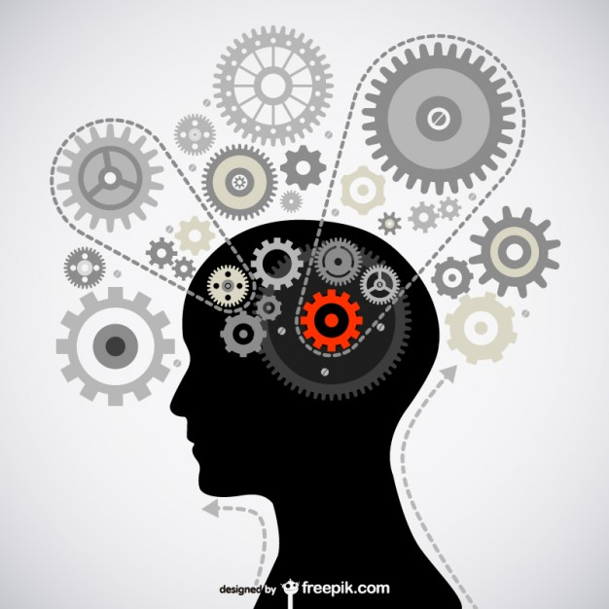
Objectives
Understand how learning capacity can be impoverished or embellished
Define resiliency, optimal performance and therapeutic lifestyle changes (TLC)
Explore recent research on neuroplasticity and TLC

Slide 3
Right Circumstances Needed to Help Brains to Grow
Change occurs when the brain is in the mood for learning (Merzenich, 2013)
The brain must judge the experience as fascinating or novel and the behavioral outcome is deemed important or just good.
Effort makes a difference for learning and change will be greater.
What changes in the brain are the strengthening of the connections.
The more powerfully connected the nerve cells are, the more reliable the behavioral productions.
The plastic paradox of positive and negative does impact us all (Doidge, 2016).
Notes:
You have heard: Neurons that fire together, wire together.
Olympics are a great example of rehearsal and mental imagery. Take the Brain Quiz.

Slide 4
READINESS CONTINUED….
Mental rehearsal assists in brain plasticity based learning.
The brain recalls the last good attempt, makes incremental adjustments and progressively improves. Memory guides most learning.
Every movement of learning offers a moment of opportunity to stabilize, so some connections will be strengthened and others lost. Negative plasticity does erase some of the relevant and essential activity of the brain (Hampton, 2016)

Slide 5
What is optimal performance?
Every person is performing all the time. Learning to calm the over-aroused parts of each of us is essential to optimal performance and functioning at our best (Sherlin, 2016)
What can we do to become optimal performers?
What threats hinder optimal performing?

Slide 6




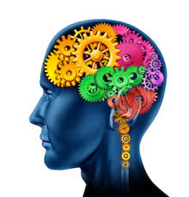
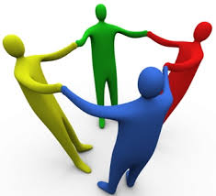
The Big Six Therapeutic Life Changes (TLC’s)
1. Sleep
2. Exercise
3. Nutrition
4. iTechnology
5. Cognitive Challenge
6. Social Relationships
Ivey, et al. (2014).
Images retrieved from Google Images
Notes:
Signs around the room with information about that topic

Slide 7
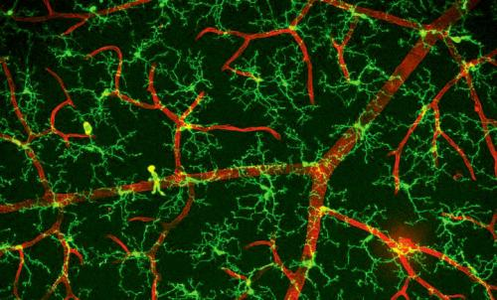
Sleep Hygiene
7-9 hour of sleep every night (Ivey et al, 2014)
Increases metabolism and hormones
Consolidates learning
Increases attention
Improves mood
Allows the microglial cells to wake up and rid the brain of residual toxins (Xie, et al. 2013)
Images retrieved from Google Images
Notes:
Raise your hand if you get 7-9 hours of sleep per night.

Slide 8
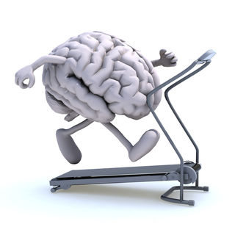
Exercise
Need at least 20-45 minutes per day with 1 minute of high-intensity interval training (Ratey, 2014)
NEAT
Enhances sleep
Produces dopamine and other BDNFs
Treats depression
Increases gray matter
Increases life longevity
Images retrieved from Google Images
Notes:
Exercise impacts the insulin like growth factor (IGF-1); vascular endothelial growth factor (VEGF); fibroblast growth factor (FCF-2) These help with building new connections and neurons.

Slide 9
Healthy Nutrition/Diet
Low fat, complex-carbohydrate, high protein diet
Eat organic and whole foods, if possible
Increases myelination
Decreases inflammation
Consult with a dietician, functional medicine physician for use of possible supplements
Assists the gut-brain axis and maintains a healthy gut microbiome
  Gut microbiome = Sixth sense
  Little use of alcohol and drugs
Images retrieved from Google Images
Notes:
Omega 3’s: Fish oil; NAC, Multiple vitamin, Vitamin D
95% of serotonin is produced in the gut;
Ivey (2015) almost every chemical that controls the brain is also located in the stomach region including hormones and neurotransmitters such as serotonin, dopamine, glutamate, GABA (gamma-aminobudtydric acid and norephineprhine
Drugs and alcohol are so disruptive to optimal health.
Pot also is found in the lower alpha waves….with continued use it causes anhedonia, loq levels of motivation and pleasure
Alcohol (sedative) increases lower level of alpha waves which is often seen in learning disorders.

Slide 10
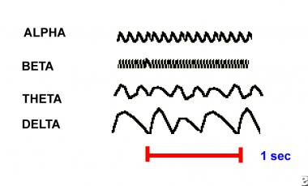
iTechnology
12 % of US are addicted; 30% in China
Too much - disrupts sleep patterns
Changes the function and structure of the brain with alpha spiking (over-aroused); 10-20% shrinkage in surface brain area (Swingle, 2015)
25 % of young people having sex while texting (Porges, 2014)
Disrupts social connection and engagement
Images retrieved from Google Images
Notes:
DSM 5 is researching adding this category
Pineal gland

Slide 11
Cognitive Challenge/Meditation
Needs to be novel and increasingly challenging
Builds neuroplasticity: adaptability of the brain; neurogenesis: new neuronal growth
Negative Bias: brain is good at remembering bad things; bad at remembering good thing
  Attention must be held for at least 10-20 seconds for positive emotions to remain
  HRV and diaphragmatic breathing will assist in over arousal.
Notes:
HRV ---Counseling Center has three counselors who are certifited.

Slide 12
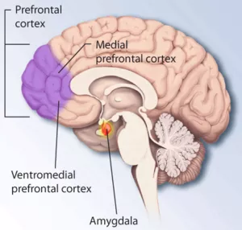
Neuroscience of Attention
Alerting-entire brain/body that begins with V, A, T, O, G: the wake-up call goes to the brainstem to produce necessary norepinephrine (Ivey, et al, 2016)
Orienting-navigation occurs by either bottom-up or top-down through goal directions
Self-regulation requires many brain connections: prefrontal cortex, insula and anterior cingulate cortex (ACC)

Slide 13
Empathy and Reflective Skills
Reflections Skills: meta-analysis by Fan et al. (2011) and Engen and Singer (2013) showed affective empathy with increased activity in the insula while the right supramarginal gyrus works to correct lack of empathy and autocorrects
Cognitive empathy is associated with higher activity in the midcingulate cortex and the dorsomedial prefrontal cortex.
When we observe others in pain, the insula and ACC are activated but not the somatosensory cortex.
Active listening actually “lights” up the brain in fMRI studies (Kawamichi et al, 2015).

Slide 14
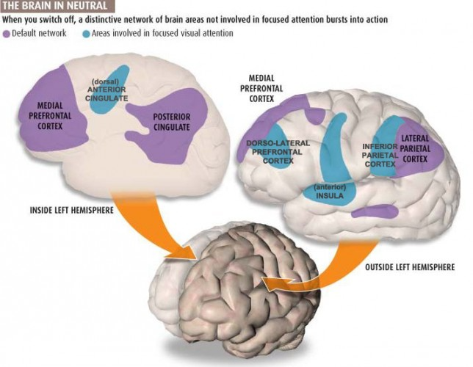
So when counselors and teachers listen…..
Abstract positive regard, such as attending behaviors, activates ventral striatum (Ivey, 2016).
Therapeutic alliance is critical in creating safety needs through the vagal nerve (Porges, 2011).
Summarizations are associated with the Default Mode Network (DMN) and reflection of self and others.
Being present (here and now) with immediacy needs involves executive functions, limbic HPA hormones, the amygdala, memory in the hippocampus using a holistic brain.
For neuroplasticity to occur, positive reflections must be maintained for 10-20 seconds…deepen responses (Hansen, 2011).
Notes:
HPA (hypothalamus pituitary and adrenal

Slide 15
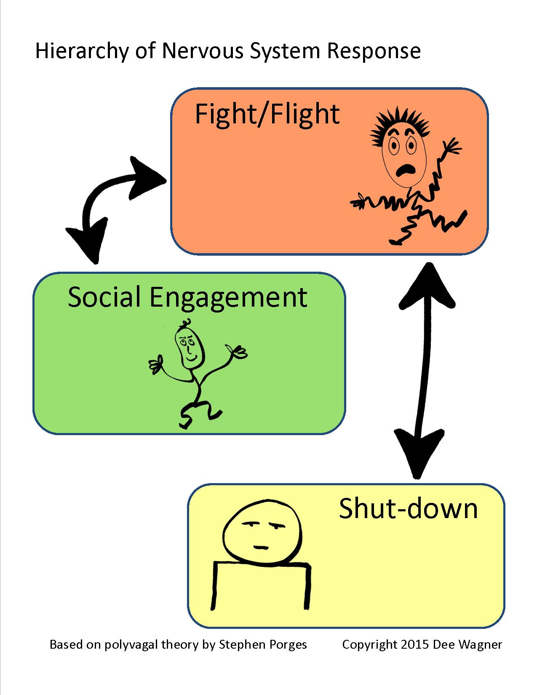
Social Relationships
Healthy interactions with others and pets
Increases levels of oxytocin
Extends the lifespan with face to face bonding
May offer “emotional and physiological safety” using the vagal nerve (Porges, 2014)
Elicits more “bottom-up and top down” communications
Eases trauma and assists the amygdala to get smaller and makes more global connections in the brain
Images retrieved from Google Images
Notes:
Porges discussed “neuroception” being prosodic speech, soft facial expression, inviting eye to eye contract

Slide 16

Building Resiliency Loads
Found that neuroplasticity of the ventromedial prefrontal cortex (VmPFC) is essential to resiliency while coping and dealing with stress (Sinha et al., 2016).
30 young adults with no previous physical/psychiatric disorders; conducted fMRIs to assess the stress response and active coping by exposing each to a block of highly aversive visual images
The control group received no stress, neutral images.
The VmPFC signals emotional and behavioral control.
Teaching the skills of reframing and reappraisal help in adaptive coping.
Notes:
Group of Yale researchers; 60 second run of images at 5 seconds per image of 10 total; subjects were tested with a subjective rating, plasma cortical levels and heart rate

Slide 17
Take the TLC Inventory!
Go to your lowest area for more specific information about that area.

Slide 18

Ride the Tiger: A guide through the bipolar brain

Slide 19
Our Goal: Professionally and Personally
Encourage neuroflexibility.
Remember the plasticity paradox.
Engage in learning, life and fun!

Slide 20

The strongest oak of the forest is not the one that is protected from the storm and hidden from the sun. It is the one that stands in the open where it is compelled to struggle for its existence against the winds, rains and the scorching sun.
- Napolean Hill
Images retrieved from Google Images

Slide 21
References
Chapin, T. & Russell-Chapin, L. (2014). Neurotherapy and Neurofeedback: Brain-based treatment for psychological and behavioral problems. Routledge, NY:NY.
Doidge, N. (2016). The brain’s way of healing: Remarkable discoveries and recoveries from the frontiers of neuroplasticity. Penguin Books, NY:NY.
Engen, H.G., & Singer, T. (2013). Empathy circuits. Current Opinion in Neurobiology, 23, 275-282. Doi:10.1016/j.conb.2012.11.003
Fan, Y., Duncan, N., de Greck, M., & Northoff, G. (2011). Is there a core neural network in empathy? An fMRI based quantitative meta-analysis. Neuroscience and Biobehavioral Reviews, 35, 903-911.
Ivey, A., Ivey, M., & Zalaquett, C. (2016). The Neuroscience of listening, empathy, and microskills. Counseling Today, 59(2), 18-21 . Alexandria, Virginia: American Counseling Association.
Ivey, A.E., Ivey, M.B. & Zalaquett, C.P. (2014). Intentional interviewing and counseling: Facilitating client development in a multicultural society. Belmont, CA: Brooks/Cole/Cengage Learning.
Hampton, D. (n.d.). The 10 fundamentals of rewiring your brain [Web log message]. Retrieved from www.thebestbrainpossible.com/the-10-fundamentals-of-rewiring-your-brain/
Hanson, R. (2013). Hardwiring happiness: The new brain science of contentment, calm and confidence. Random House, NY:NY.
Kawamichi, H., Yoshihara, K, Sasaki, A.T., Sugawara, S.K., Tanabe, H.C., Shinohara, R, ....Sadato, N. (2015). Perceiving active listening activates the reward system and improves the impression of relevant experiences. Social Neuroscience, 10, 16-26. Doi: 10.1080/17470919.2014.954732.
Merzenich, M. (2013). Soft-wired: How the new science of brain plasticity can change your life. Parnassus Publishing: San Francisco, CA.

Slide 22
References continued
Pandi-Perumal, S.R., Narasimhan, M. & Kramer, M. (2016). (eds). Sleep and psychosomatic medicine. Taylor & Francis Group: Boca Raton, Fl.
Porges, S. (2014). Clinical insights from the polyvagal theory: The transformative power of feeling safe. W.W. Norton & Co: NY, NY.
Porges, S. (2011). The polyvagal theory: Neurophysiological foundations of emotions, attachment, communication and self-regulation. W.W. Norton & Co: NY, NY.
Ratey, J. & Hagerman, E. (2008). Spark: The revolutionary new science of exercise and the brain. Little Brown and Co: NY, NY.
Ride the Tiger [DVD] (2016). Detroit Public Television.
Sherlin, L. (2016). Personal communication.
Sinha, R., Lacadie, C.M., Constable, R.T. & Seo, O. (2016). Dynamic neural activity during stress signals resilient coping. Professional National Academy of Sciences, July. doi: 10.1073/pnas.1600965113.
Swingle, M. K. (2015). i-Minds: How cell phones, computers, gaming and social media are changing our brains, our behavior and evolution of our species. Inkwater Press: Portland, OR.
Xie, L., Kang, H., Xu, Q., Chen. M., Liao, Y., Thiyagarajan, M., O'Donnell, J., Christensen, D., Nicholson,C., Iliff, J., Takano, T., Deane, R. & Nedergaard, M. (2013). Sleep drives metabolite clearance from the adult brain. Science, v342(6159), pp.373-377. doi10.1126/science.1241224.

