Slide 1
Plagiarism Awareness: Strategies for Education
& Prevention
Jana Hunzicker & Barb Kerns
Center for Teaching Excellence and Learning (CTEL)
Bradley University
August 24, 2015

Slide 2
Overview
Bradley’s New Plagiarism Awareness Module and Quiz
Strategies for Helping Your Students Avoid Plagiarism
Turnitin Plagiarism Detection Tool
Bradley’s Next Steps
Questions

Slide 3
Plagiarism Awareness Module & Quiz

Slide 4
2012-2013
Concern expressed to the University Senate:
Frequent incidences of plagiarism by Bradley students over several years’ time
Bradley students not knowing Bradley’s policy for plagiarism or the consequences for plagiarism

Slide 5
2013-2014
Bradley’s ARDR Committee reviewed Bradley’s policy for plagiarism and determined:
The policy and consequences for plagiarism were appropriate
Bradley’s C&R Committee decided:
CTEL should lead the process of creating a plagiarism awareness module to teach Bradley students what plagiarism is and how to avoid it, followed by a quiz to document students’ understanding

Slide 6
2014-2015
CTEL convened the Plagiarism Awareness Task Force (PATF):
Met October through April
Developed the plagiarism module, quiz, and procedures for implementation
Representation from 4 of Bradley’s 5 colleges, CTEL, the Graduate School, and the Office of Student Affairs
Several others provided technical support or appeared in the videos

Slide 7
Module
Accessible to anyone via the Bradley website:
A-Z Index: Plagiarism Awareness
Brief opening and closing videos featuring ten Bradley faculty, professional staff, and students
2,000 words; about 10 webpages

Slide 8
Quiz
Accessible to anyone with a Bradley login and password:
10 question multiple choice, true-false quiz
Immediate feedback (per question and at the end of the quiz)
Criterion for passing: 7/10
Can be taken as many times as desired
Quiz score feedback message can be printed by the student as documentation of completion

Slide 9
Features
Bradley’s Plagiarism Awareness Module and Quiz is designed to be:
Generic – applicable to all academic disciplines
Supportive – raises student awareness of what plagiarism is and how to avoid it
Proactive – educates and documents student understanding before a problem arises
Low stakes – low passing score, multiple quiz attempts
User-friendly – minor time commitment (20-30 minutes), can be completed any time/anywhere

Slide 10
Implementation
Completion of the module and quiz are required for all incoming freshman, transfer, and graduate students:
Introduced during summer 2015 orientations
Two reminders to complete the module and quiz before classes begin
One more reminder will be sent in early October
Registration holds will be placed on all incoming students who have not passed the quiz by the first day of registration
The hold can be lifted by passing the quiz

Slide 11
Maintenance
Each quiz attempt will be recorded in a database and saved for the duration of a student’s time at Bradley.
The information can be accessed by the dean of each college and the VP for Student Affairs, as needed.
Improvements/updates to the module and quiz:
Fall 2015: CTEL will take primary responsibility
2016-2017: CTEL and Bradley’s Writing Center will work together to maintain the module and quiz.

Slide 12
Strategies for Helping Students Avoid Plagiarism

Slide 13
Strategies
Include a statement about plagiarism in your syllabus, and discuss it on the first day of class.
With each assignment, remind students of the importance of using their own words and giving credit to their sources.
Design assignments that are difficult to plagiarize.
Reflective/autobiographical
A combination of two topics
A unique topic or a specific outline

Slide 14
Strategies
Require submission of assignments in stages, or monitor checkpoints along the way.
List of possible sources, notecards, first draft, etc.
Allow writing/preparation time in class.
Require presentation or sharing of the completed assignment.
Require students to take the Bradley Plagiarism Awareness Module and Quiz and bring you their documentation of a passing score.
Let your students know that you use Turnitin.

Slide 15
Turnitin Plagiarism Detection Tool

Slide 16
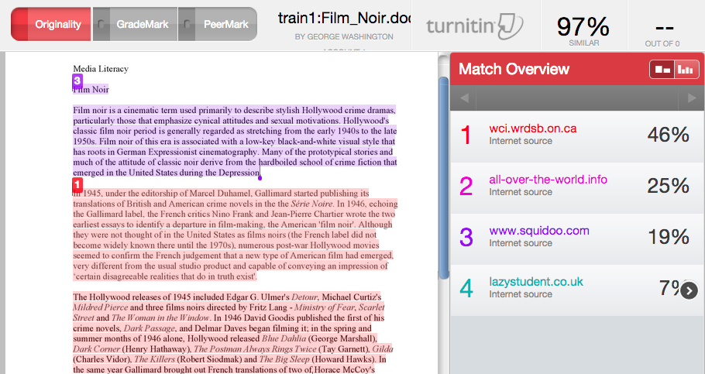
Turnitin
Highlights matching text and indicates the source of the match
Allows for filtering out quotes, bibliographies, and # string of words
Allows exclusion of sources
Allows downloading of report

Slide 17
Turnitin Demonstration

Slide 18
Bradley’s
Next Steps

Slide 19
2015-2016
The Plagiarism Awareness implementation process will be repeated each semester.
Orientation, 3 reminders, registration hold
Full implementation by 2018-2019
This year, a Plagiarism Awareness module will be created for Bradley faculty
Committee representatives (TBA) from all 5 colleges, the Graduate School, and the Office of Student Affairs
Focus on how to help students avoid plagiarism and what to do when plagiarism is suspected

Slide 20
Questions?

