Slide 1
The Faculty Role in Student Success
Khadish O. Franklin
Director, Strategic Research
Kfranklin@eab.com

Slide 2
2010: Peak Post-Secondary
Student Enrollments (1985-2016)
Source: National Center for Education Statistics, Digest of Education Statistics, 2017

Slide 3
Looming Birth Dearth
Population of 18-Year-Olds to Contract Sharply After 2025
Modest Decrease…
…Followed by Growth Spike…
…Met with A Sharp Decline
2017-2021
2022-2025
2026-2029
2025 Population
4.51 Million 18-Year-Olds
2021 Population
2017 Levels
2029 Population
4.17 Million 18-Year-Olds
3.86 Million 18-Year-Olds
-1%
8%
-14%
Decrease of 18-Year-Olds
(2017-2021)
Growth of 18-Year-Olds
(2022-2025)
Decrease of 18-Year-Olds (2026-2029)
Sources: Grawe, Nathan D., Demographics and the Demand for Higher Education, 2017; EAB analysis.

Slide 4
Diverging Fortunes by Region
Falling Birthrates From 2007 to Present Projected to Hit HEIs Across the US
Projected Percent Change in the Population of 18-Year-Olds, 2017-2029
11% to 30%
growth
0% to 10%
growth
-1% to -9%
decline
-10% to -19%
decline
-20% +
decline
Sources: Grawe, Nathan D., Demographics and the Demand for Higher Education, 2017; EAB analysis.
Notes:
Speech Overview: The first demand risk factor that we’ll discuss is around fertility rates as its foundational to any discussion on future enrollment. As we can see from this map, there isn’t a glimmer of hope for most states. But what we’ll aim to illuminate on the next few slides is that there are other enrollment demand factors that we can inflect to reverse the losses from declines in fertility rates.

Slide 5

Higher Ed’s Three Most Pressing Challenges
Will Our Business Model Survive?
“The competitive landscape has never been more challenging – both in traditional and new markets.”
The Student of the Future
“We are not prepared for how student needs and preferences are rapidly evolving.”
Crisis of Confidence in Higher Education
“Perception has never been so negative—from all directions.”

Slide 6

Getting Ready for the Student of the Future
Preparing Not Only for Changes in Demographics…
…But Also a Change in College-Going Attitudes
-10%
A resurgence of the trades?
“Men who otherwise would likely attend community colleges are now finding employment opportunities in areas like manufacturing.”
“We appear to be approaching a time when, even for middle-class students, the economic benefit of a college degree will begin to dim.”
Students with household incomes >$100K
(2017-2029)
-19%
The New York Times
The Wall Street Journal
April 26, 2018
Non-Hispanic white 18-year-olds
(2012-2029)
“It’s the manly-man jobs that are finally coming back…Men who otherwise would likely attend community colleges are now finding employment opportunities in areas like manufacturing.”
Is college worth it?
“We appear to be approaching a time when, even for middle-class students, the economic benefit of a college degree will begin to dim.”
64%
18-year-olds in a household where neither parent holds a bachelor's degree (2029)
The New York Times
May 16, 2018
The Wall Street Journal
Source: Nathan D. Grawe, Demographics and the Demand for Higher Education, (Baltimore: Johns Hopkins University Press, 2018); Melissa Korn, “Fewer High-School Grads Enrolled in College Last Year," Wall Street Journal, April 2018; Bureau of Labor Statistics; Ellen Ruppel Shell, “College May Not Be Worth It Anymore” The New York Times, May 16, 2018; EAB interviews and analysis.

Slide 7

The Affordability Issue
Students Ruling Schools Out on List Price Alone
Attitudes Shifting with Demographics
Percentage of students reporting “major” concern about financing college
Demographic change in HS graduates, 2017-2031 (in thousands)
69% of students have some (or major) concern about financing college
59% of students consider only list price when evaluating schools early in the process
17% of students ruled out a school they will apply to because of cost
>50% of students from families earning less than $120,000 per year say they cannot afford to attend a private college or university
Sources: Richard A. Hesel and Ryan C. Williams, “Students and Parents Making Judgments about College Costs without Complete Information,” Student Poll, vol. 8, 1, 2010; Kevin Eagan et. al., “The American freshman: National Norms Fall 2016,” Higher Education Research Institute, 2017; Peace Bransberger and Demarée K. Michelau, “Knocking at the College Door,” WICHE, December, 2016; Student Loan Hero fast facts; Royall and Company, “Access and Higher Education: The Case of High-Ability Low-Income Students,” Fall, 2014.

Slide 8


College More Expensive Than Ever…Every Year
High Costs and Staggering Debt Not a New Conversation
Growth in College Costs Continues…
…And Student Debt Reaches Crisis Levels in 2018…
Net Tuition, Fees, Room and Board at Private Institutions (in Constant 2018 dollars), 2000 – 2018
“Student Loan Debt Statistics in 2018: A $1.5 Trillion Crisis”
23%
Growth in Net TFRB since 2000, while real median household income grew only 3%
…And in 2015…
“Student Debt is worse than you think”
…And 2012…
“The Student Loan Crisis is Crippling America’s Families”
Net TFRB
Great Recession
Source: Trends in College Pricing Source Data File. College Board as of November 2018; Market Outlook, July 2018 Median Household Income. Seeking Alpha. August 2018; Friedman, Z. Student Loan Debt Statistics In 2018: A $1.5 Trillion Crisis. Forbes. January 2018; Carey, K., Student Debt Is Worse Than You Think. October 2015. The New York Times. Nance-Nash, S., The Student Loan Crisis Is Crippling America's Families -- Is The Economy Next? February 2012. Forbes. EAB interviews and analysis.
Notes:
Tone: this is old news.
We’ll start our discussion today with a graph that we’ve all seen before. College costs continue to rise and this has been true for decades now. When we plot the growth the net tuition over time, we find that the cost of going to college, measured in terms of net tuition, fees, room and board at private institutions has been increasing every year for the last two decades with the exception of a few years during the Great Recession. We’re not even talking about published tuition and fees, that our students and families read about in the headlines. We’re talking about net and since 2000, we’ve seen a 23% increase in average net TFRB, while the median household income grew by only 3%.
What our families also understand and have heard loud and clear is that debt continues to accumulate. A few years ago when started talking about debt at EAB, we showed to you a number that seemed astronomical. It was 1.1 trillion in student debt. When we unpacked that number, we found that lots of it came from the for-profit world, lots of it is graduate debt. We found that some of this debt is actually good debt – it means more students are in college, there are more borrowers than in the past. But that nuance is getting lost. Just a few years later, the 1.1 trillion has increased to 1.5 trillion and we’re still trying to outrun the narrative of toxic student debt. It has now gone from just a difficult story to almost a punchline.

Slide 9










Generation Z Brings New Challenges
Traits, Preferences of Today’s Students Manifested in Lifestyles
Generational Traits Ages (13-21)
Focus: Practical, Open, Connected
A Typical Day in the Life of a Gen Z’er
Tech driven – Prone to unplug, yet hyper connected; expects smart, flexible tech
Digital natives- Comfortable with technology at a very early age
Open to sharing – Puts lives online without filter
Self-Educators – Uses online media; has seen it all
Touches 5+ devices
Generational Traits
Engages in 3+ hours of screen time
Surfs 2 screens simultaneously
Expects an app for everything (banking, dinner reservations, etc.)
Marketing or Communication Preferences
Focus: Humanity, Collaboration, Sharing, Personal
Expects authenticity - Expects demonstrated commitments to worthy causes
Personalized – Prefers customized content
Shared values -Needs to establish common ground to build trust, loyalty
FOMO (Fear of Missing Out) - Needs to be in the loop; driven to connection via social media
Is social media savvy from an early age
Messaging Preferences
Prefers to swipe over type
Uses images over text
(TLDR – Too Long,
Didn’t Read)
Sources: Laurence Benhamou, “Everything you need to know about Generation Z,” Business Insider, 12 Feb 2015; EAB interviews and analysis.
Notes:
http://www.businessinsider.com/afp-generation-z-born-in-the-digital-age-2015-2
https://www.eab.com/daily-briefing/2016/01/11/move-over-millennials-generation-z-is-coming-to-college :
ttps://www.eab.com/SearchAll?q=generation%20z&fq=_readaccessids_int_mv|

Slide 10
Depression and Anxiety on the Rise Among Teens
A Silent Epidemic Is Coming to Campus
Escalating Rates of Depression
External Factors Driving Up Demand
Past Year Major Depressive Episode¹ Among Adolescents, By Gender (2011-2015)
Substance Abuse
Students look to drugs and alcohol to relax; use prescription drugs to focus, work late into the night
Intensified Expectations
Students face early and persistent pressure to academically excel, fit in socially, and be successful after graduation
Social Media
Time spent online amplifies existing stressors and contributes to an overwhelming sense of social isolation on campus
Political Climate
Stress from current events and politics exacerbates students’ existing issues with stress, anxiety, and depression
5x
  Rate at which counseling center utilization outpaced enrollment growth
New Parenting Styles
Highly involved parenting creates busy, overscheduled, failure-averse students who struggle to adapt to challenges as they arise in college
A major depressive episode is characterized as suffering from a depressed mood for two weeks or more, and a loss of interest or pleasure in everyday activities, accompanied by other symptoms such as feelings of emptiness, hopelessness, anxiety, and worthlessness.
Source: National Institute of Mental Health, “Major Depression Among Adolescents,” https://goo.gl/KSk7xT; Olfson M et al, “Trends in Mental Health Care among Children and Adolescents,” The New England Journal of Medicine, https://goo.gl/3GjjFn; Merikangas K
et al, “Lifetime Prevalence of Mental Disorders in US Adolescents: Results from the National Comorbidity Survey Replication…,”
Journal of the American Academy of Child & Adolescent Psychiatry, https://goo.gl/apDwDe;” EAB interviews and analysis.
Notes:
By all indication, the demand is only going to continue to grow on campus.
Data shows that depression and anxiety are on the rise among teens.
Last few years have shown steadily climbing rates in the number of adolescent girls and boys who suffered from a major depressive episode in the last 12 months.
And that’s just the start.
Today, 1 in 4 teens meet the criteria for an anxiety disorder.
8% of children have attempted self-injury
When these kids come to campus, they are thrust into a new routine with significant and new stressors. They are going to need help to cope with their new environment, and they will look to counseling services to provide that assistance.

Slide 11
Beyond the Completion Binary
Student Success Encompasses More Than Graduation Success
Defining Student Success by How It’s Measured
Graduation Success
Student Success
Access
Retention
Degree Progress
Completion
Intellectual, Social, and Emotional Development
Post-Graduation Financial Wellness
Career Engagement
?
Foundational
Holistic
Progressive Outcomes

Slide 12
A Similar Story Nationwide
Flat Graduation Rates, Despite Significant Student Service Investments
11%
Average Five-Year Graduation Rates¹
Public and Private US Universities
Average growth in student services spending per student FTE AY 2001-2011
Data reflects share of first-time students who have received a bachelor’s degree within 5 years
Source: ACT Research, Delta Cost Project, “Trends in College Spending, 2001-2011: A Delta Data Update,” 2014.

Slide 13
A Different Landscape for Recruitment
Source:
Shifting Demographics
A More Demanding “Shopper”
+52,000
Median miles traveled from home to college by ethnicity
108%
Projected growth in Hispanic high school graduates between 2017-2031, while white grads decline by 122,000
Increased applications from 2001—2014 with just an 11.6% increase in prospects
87%
42
Hispanic
Percentage of prospects who say they don’t trust university websites, seeking validation from externals source
40
Asian
22%
Distance ed won’t save us
Of online students in 2017 enrolled at institution less than 100 miles from home (52% less than 50 miles)
79
White
Increase in withdrawn deposits from 2007-2015
72%
78
Black
Increasingly Price Sensitive
25%
Percentage of families who would have enrolled elsewhere for less than $5k in additional grant or scholarship assistance from second choice
Public K-12 Students Approved for Free or Reduced Price Lunches, 1989-2016
NACUBO-Reported Discount Rate for FTFT Freshmen
See Appendix (EAB Draft Stakeholder Education Builder) for state-by-state slides
38.6%
49.1%
in 2006-2007
in 2016-2017
Source: “DepositIQ Survey 2016,” EAB Royall & Company, 2016; “Graduate Enrollment and Degrees: 2005-2015”; Trends in College Pricing, College Board, 2016; Selingo J, The Future of Enrollment, The Chronicle of Higher Education, 2017; Western Interstate Commission for Higher Education, Knocking at the College Door: Projections of High School Graduates, 2016; “Rise in student applications creating greater financial risk for some colleges,” Moody’s Investors Service; Jon McGee, Breakpoint: The Changing Marketplace for Higher Education (Johns Hopkins University Press, 2015); “How America Pays for College,” Sallie Mae, “The Student Customer Journey,” Learning Places, 2015

Slide 14
What Actually Happens to Our Students?
A True Perspective on Outcomes Demands a New Set of Success Metrics
For Every 100 Students Who Start a Bachelor’s Degree…
22
Drop out
of college
12
Still enrolled after six years
33
Earn an associate’s
28
Graduate but are underemployed
35
Graduate and are working a job requiring a BA by age 27
Our new student success mandate:
Graduate
more students…
…in less time,
at lower cost…
…with better
post-grad outcomes…
…to deliver a better
Return on Education
Source: Shapiro D, et al., “Completing College: A National View of Student Attainment Rates – Fall 2010 Cohort (Signature Report No. 12)” National Student Clearinghouse Research Center (2016); Federal Reserve Bank of NY: https://www.newyorkfed.org/research/college-labor-market/college-labor-market_underemployment_rates.html#; EAB interviews and analysis

Slide 15


A Tale of Two Research Conversations
Existence of Best Practices Does Not Equal Effectiveness
Institution A
Institution B
Meta Majors
Meta Majors
Student success course
Student success course
Tech enhanced advising model
Tech Enhanced advising model
Learning communities
Learning communities
Intensive coaching for underperforming students
Intensive coaching for underperforming students
Accelerated remediation
Accelerated remediation
Lots of Effort, Minimal Gains “Each pilot has worked fairly well, but we haven’t seen our retention and completion rates rise. Did some of the research misstate the benefits of these programs?”
President, Large Research University West Coast
20%
Increase in fall-to-fall retention rate
15%
Increase in six-year completion rates
Source: EAB interviews and analysis.
Notes:
Pull back curtain again
As you know we have hundreds of research conversations each year
As we started them, we wondered if certain institutions had just found the key best practices to move the dial
The convos sounded almost identical
As we digested, it became clear that the difference wasn’t BPs…IT WAS CHANGE MANAGEMENT

Slide 16
Breakaway Performers in Every Selectivity Band
Getting to Best-Demonstrated Peer Performance Holds Huge National Gains
Four-Year Graduation 25th to 75th Percentiles, by ACT Composite Midpoint¹
Highest Volatility in Middle Selectivity
Inclusive
Moderately Selective
Most Selective
Interquartile Range
Upper/Lower Extremes
n=1105
Source: EAB Analysis of 2014 IPEDS Data
Notes:
Breakaway performers in every selectivity band
Even the top performers in a band are outperforming the lowest performers several selectivity bands up

Slide 17
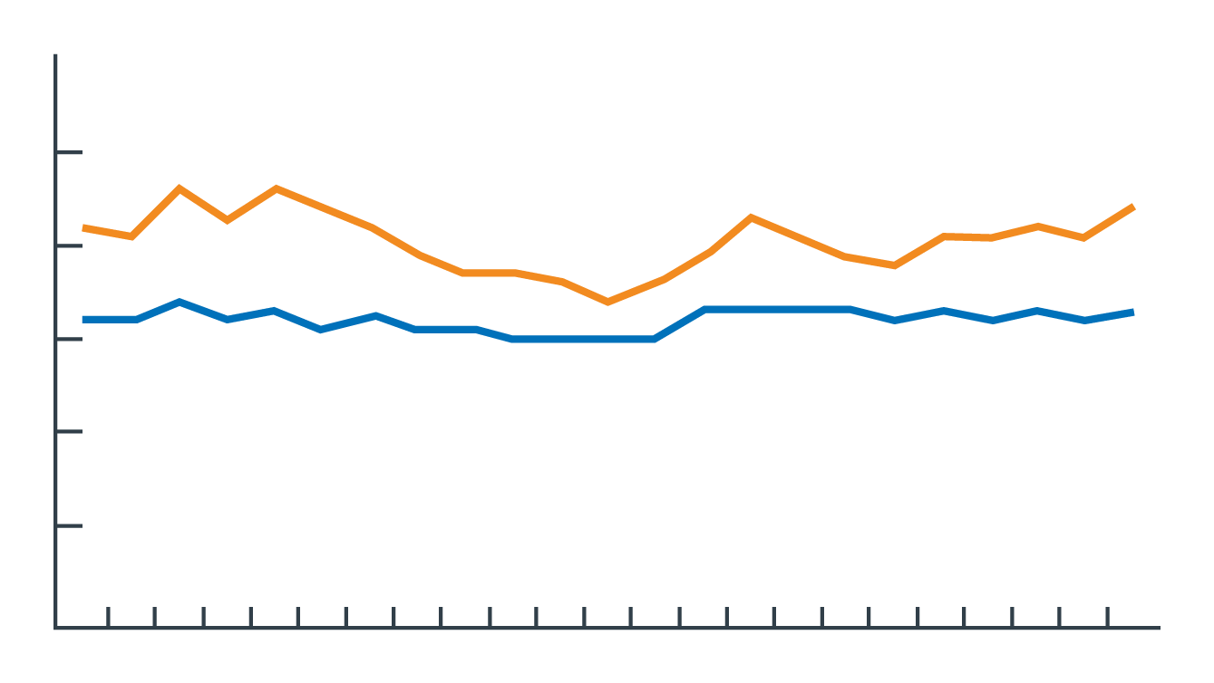
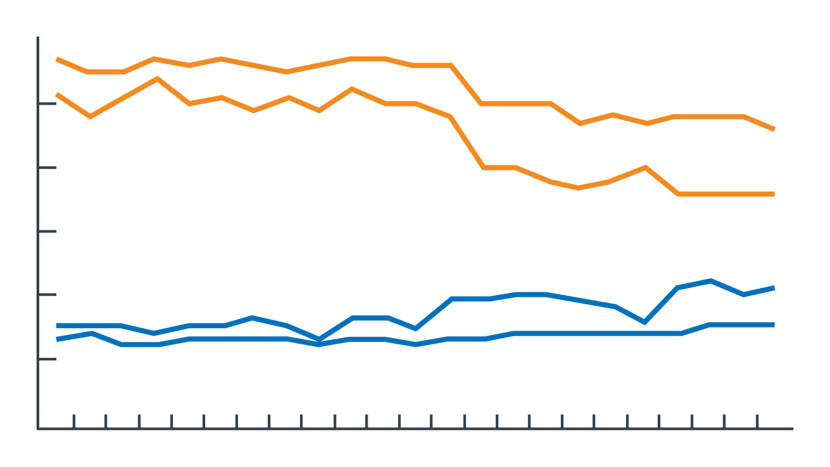
Is There a True Skills Gap?
Unclear Who to Blame for Post-Graduation Underemployment
Underemployment Rates Rising for Recent College Graduates
Job Quality¹ Among Underemployed College Graduates Decreasing
60%
60%
Good non-college jobs:
College graduates
50%
Recent college
graduates
50%
Good non-college jobs:
Recent college graduates
40%
40%
30%
30%
Low-wage jobs:
Recent college graduates
College graduates
20%
20%
10%
10%
Low-wage jobs: College graduates
0
‘10
‘12
0
1990
‘92
‘94
‘96
‘98
‘00
‘02
‘04
‘06
‘08
1990
‘92
‘94
‘96
‘98
‘00
‘02
‘04
‘06
‘08
‘10
‘12
New York Fed, analysis of Census and Bureau of Labor Statistics, Current Population Survey, Dept of Labor, and O*NET data.
96%
Of provosts say their graduates are prepared to succeed in the workplace²
11%
Of business leaders strongly agree that graduates are prepared to succeed at work³
Defined by higher salary, skill requirements, and career orientation (i.e. electrician vs. cashier).
2014 Inside Higher Ed Chief Academic Officer Survey.
Gallup & Lumina Foundation, “What America Needs to Know About Higher Education Redesign,” 2014.
Source: New York Fed, “Are Recent College Graduates Finding Good Jobs?,” Current Issues in Economics and Finance, Vol 20 No 1.

Slide 18
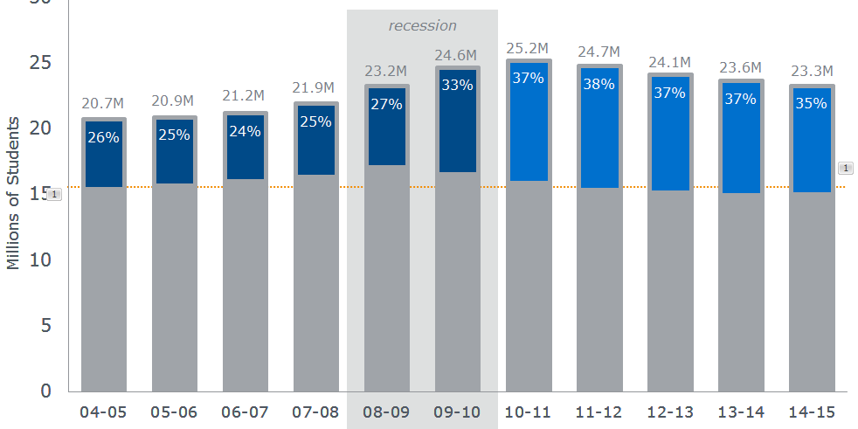
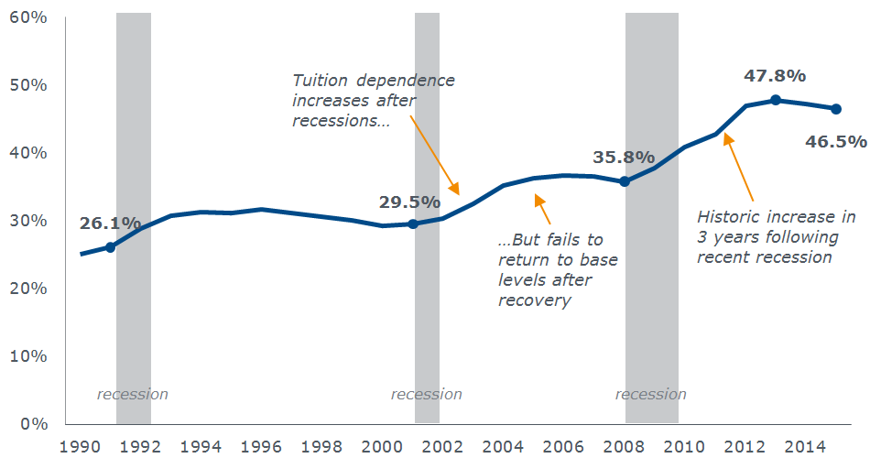
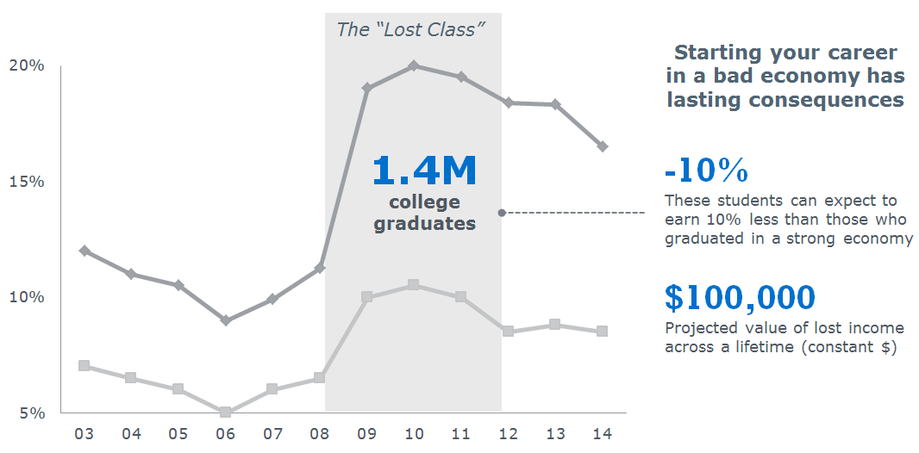

The Recession Changed the Definition of Success
Our New Agenda: Generate a ‘Return on Education’
Unprecedented numbers of higher-risk students
Greater financial burden placed on families
Rising concern over post-grad employment
Goal 1
Ensure more
students graduate
Goal 2
Reduce the total
cost to degree
Goal 3
Elevate post-graduate outcomes
Return on Education (ROE)
Source: EAB interviews and analysis.

Slide 19





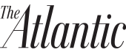
An Equity Moment in Education and Beyond
Political and Social Forces Bring Historical and Current Inequalities to Light
“’Being Not-Rich’: Low-Income Students at Michigan Share Savvy Advice”
“Canadian Universities, Colleges Working to Indigenize Programs, Campus Life”
“Mobility Report Cards: The Role of Colleges in Intergenerational Mobility”
Equality of Opportunity Project
“UNC Boards Meet in Aftermath of Confederate Statue Toppling”
University of North Carolina System emphasizes rural student gaps in campus evaluation
“A Black Smith College Student Was Eating Her Lunch When an Employee Called the Police”
“Higher Education Alone Can't Bridge the Wealth Gap That Separates Black Americans from Their White Peers.”
“Long After Protests, Students Shun the University of Missouri”
2023
Projected year when U.S. high school graduating class becomes majority-minority
Source: From news organization websites, full list available upon request; Rick Seltzer, “The High School Graduate Plateau”, Inside Higher Ed, December 6, 2016; EAB interviews and analysis.

Slide 20
A Historic Demographic Shift
Students Coming from Less Affluent and Less Well-Prepared Backgrounds
Growth in Lower Income Families Outpacing Rest of Nation
Percentage Growth, 2000-2013
262
points
Difference in average SAT 1600 score between lowest and highest income students
Total Growth 15.5%
Sources: US Census Bureau; http://www.pewresearch.org/fact-tank/2014/01/15/college-enrollment-among-low-income-students-still-trails-richer-groups/; http://blogs.wsj.com/economics/2014/10/07/sat-scores-and-income-inequality-how-wealthier-kids-rank-higher/; EAB interviews and analysis.

Slide 21
Starting Late From the Outset
Status Quo Systematically Underloads URM and Transfer Students
URM Students All but Destined for 5-Year Graduation
Transfers Racing Against Pell Eligibility Clock
Remediation Enrollment
1st-Year Credits Earned, High Ability Students
28%
28.5
20%
26.5
17%
Community college transfer students that do not complete in 4 years
White
Transfer students are constrained by Pell lifetime eligibility, but they also register last. It is even more important that we get them started off right.”
Hispanic
White
Black/ African American
Black/Hispanic
Michael Herndon, Director, Office of Summer and Winter Sessions
Virginia Tech University
Sources: EAB Analysis of BPS Longitudinal Study 04/09 Cohort; Paul Fain, “Starting all Over Again,” Inside Higher Ed, March 19, 2014; National Student Clearinghouse Research Center, “Transfer Outcomes,” 2012; EAB interviews and analysis.

Slide 22









Focusing on What Higher Ed Can Control
What Institutions Do (or Don’t) to Create or Worsen Gaps
Seeking to Increase Access and Improve K-12 Education
Helping to Create Jobs and Meet Employer Workforce Needs
Overcoming Barriers to Equity in Student Success on Your Campus
Two Guiding Questions
“What gaps do we have to react to and attempt to remedy?
“What gaps do we contribute to or make worse by action or inaction?”
Source: EAB interviews and analysis.

Slide 23
An Organizational Dilemma
Who “Owns” Student Success On Your Campus?
Provost
Enrollment Manager
VP of Undergraduate Studies
VP of Student Success
VP of Student Affairs
Academic Deans
Admissions
The First Year Experience
Departmental Programming
Success data and dashboards
Orientation
Scholarships and Aid
Honors Programs
Curricular Design
Overseeing initiatives
Student Involvement
Stop-Out Recruitment
Undeclared Advising
Academic Advising
Advising policies and practices
Counseling Interventions
The Student Success Office
“I know how to manage to numbers, not just ideas”
“I have academic credibility and run the first year”
“We own the curriculum and the purse strings”
“Student success needs to be someone’s job”
“I understand the non-academic roots of attrition”
Source: EAB interviews and analysis.

Slide 24
Existence Does Not Equal Effectiveness
No Shortage of Best Practice Programs in Place, But Little to Show For It
Despite Prevalence of High-Impact Practices, Each Campus Lagged Behind Peers
Checking the Box “Either these things are only happening one or two places on campus, or they’re written down on paper somewhere but not actually in practice. Something doesn’t add up.”
Vice President for Academic Affairs State University System
Source: EAB interviews and analysis.

Slide 25
Competency #4: Course Redesign
Faculty at the Center of Student Success
Research on Retention and Long-Term Outcomes Confirms Critical Role
Contributing to Persistence “In accordance with Chickering and Gamson, several researchers documented the strong association of both formal and informal faculty-student contact to enhanced student learning. These interactions influenced the degree to which students became engaged with faculty and were frequently the best predictors of student persistence (Braxton, Sullivan, & Johnson, 1997; Hurtado & Carter, 1997; Pascarella & Terenzini; Stage & Hossler, 2000).”
Paul Umbach and Matthew Wawrzynski “Faculty Do Matter: The Role of College Faculty in Student Learning and Engagement”
Contributing to Well-Being “[I]f graduates had a professor who cared about them as a person, made them excited about learning, and encouraged them to pursue their dreams, their odds of being engaged at work nearly doubled, as did their odds of thriving in their well-being … Feeling supported and having deep learning experiences means everything when it comes to long-term outcomes for college graduates … Yet few college graduates achieve the winning combination. Only 14% of graduates strongly agree that they were supported by professors who cared, made them excited about learning and encouraged their dreams.”
Great Jobs, Great Lives The 2014 Gallup-Purdue Index Report
Source: Paul D. Umbach and Matthew R. Wawrzynski, “Faculty Do Matter: The Role of College Faculty in Student Learning and Engagement,” Research in Higher Education (2005); “The 2014 Gallup-Purdue Index Report,” Lumina Foundation (2014); EAB interviews and analysis.

Slide 26

Top-Down Changes Rarely Stick
Faculty Buy-In Critical to Organizational Improvement
Reduce and standardize number of credits required by majors for graduation
Create new professional advising roles to help high-risk students navigate early years
Implement early warning system to track attendance and early performance
Hire instructional design staff to help faculty improve assessment design
Program heads may perceive as threat to reputation and rigor
Units may fear loss of control over curricular advice
Faculty either unaware or view as busywork
Non-innovator faculty feel redesign not worth effort
4-year graduation rate stagnant, students struggle with aid limits and major changes
First-year and undeclared students drop out at high rates, pursue poor-fit programs
Preventable issues go unaddressed, and many students aren’t contacted until withdrawing
High-failure courses hamstring first-year students, forcing repeats and remediation
Unable to enact change without buy-in or approval
Changes enacted, but aren’t complied with or embraced
Source: EAB interviews and analysis.

Slide 27
Competency #2: Policy and Curricular Infrastructure
Faculty Influence Extends Beyond the Curriculum
Policy Decisions Have Direct and Indirect Effects on Student Progression
Course Planning
Departments plan sections one term at
a time, limiting long-term planning
Withdrawal Process
Easy Yes/No prompt for course or institutional withdrawal leads to poor student decisions
Registration Holds
Small, unpaid bursar fees lead to hundreds of stop-outs after registration hold
Enrollment Status
Many students take light course loads without anticipating impact on time-to-degree
Progression-informed policy change
Multi-term scheduling
Annual course planning period enables full-year course registration for students
3% retention gain at Cleveland State University
Withdrawal surveys
Automated advising prompts walk students through consequences and campus resources
40% of students starting survey retained at Penn State
Emergency Grants
Students missing fee payments proactively counseled and assisted in exceptional cases
5-8% retention gain at Xavier University
Redefine “Full Time”
Students advised to take at least 30 credits per year unless they face serious conflicts
Higher course loads led to higher GPAs and grad rates at University of Hawaii
Source: EAB interviews and analysis.

Slide 28
Not Just the Student’s Fault
Failure Rates Vary Drastically, Even Within a Single Course
Instructors Often a Major Source of Variability
Completion Rates for Sections of Same Course at More Selective, Public Research University
Source: Academic Performance Solutions data and analysis; EAB interviews and analysis.

Slide 29








Prioritizing Investments in Course Redesign
Identify Courses Where Improvements Would Have the Greatest Impact
Course Redesign Prioritization Criteria
Redesigns entire courses within a department, rather than individual sections
Demonstrates support from departmental faculty, chairs, and deans
Targets general education, introductory, and/or prerequisite gateway courses
Includes a plan for financial sustainability and/or an overall reduction in costs
Targets courses with historically high DFW (D/F/withdraw) rates
Describes how the course will use technology to reduce costs and improve outcomes
Targets high-enrollment courses with seat capacity constraints
Preserves academic rigor and course content while adapting delivery methods
For more information and resources, see the National Center for Academic Transformation’s online repository at thencat.org
Source: EAB interviews and analysis.

Slide 30

Addressing Faculty Concerns
When You Say “Reduce DFWs,” They Hear “Lower Academic Standards”
Common Faculty Concerns About Course Redesign
Factors Out of My Control
Reduces Institutional Rigor
High course failure rates are due entirely to poorly prepared students, increasing class sizes, greater use of adjunct instructors
Calls to improve course completion rates are actually implicit demands to reduce the rigor of instruction
Administrative Overreach
Way to Increase Workload
Efforts to improve course completion rates represent administrative interference in teaching
Course redesign is just a way to enlarge class sizes and increase faculty workload
We Need to Weed Out Students
Rewards Bad Teaching
Gateway courses need to screen out students and limit entrance to oversubscribed majors
Giving more resources to instructors with low completion rates is “rewarding bad teachers”
Source: EAB interviews and analysis.

Slide 31

A Networked Approach to Ownership
Intentional Blurring of Boundaries Reflects Holistic Student Goals
Only 55% report to Student Affairs, down from 68% in 2008¹
41% have recently changed their name or rebranded²
82% of faculty believe it is “essential” or “very important” to prepare students for post-graduation employment, up from 73% in 2005³
Provost
Evolving “Parallel” Services to Meet Student Needs
Academic and Career Development Strategy
Engaging the Academy in Experiential Learning
Student Affairs
Campus Involvement
Program Design
Career Advising
Active Learning
Career Mentoring
Curricular Planning
Outcomes Marketing
Service Learning
Deans and Chairs
Career Services
Teaching & Learning
Alumni Relations
Academic Advising
Enrollment Management
NACE, “Career Services Offices: Office Structure and Organizational Design,” 2016.
York College of Pennsylvania, “2014 National Professionalism Survey, Career Development Report”.
HERI Surveys of Undergraduate Teaching Faculty, 2004-05 and 2013-14.
Undergraduate Studies
Source: EAB interviews and analysis.

Slide 33
Competency #1: Academic Advising
How Has the Role of the Advisor Evolved?
Moving Beyond Registration to Put Student Success at the Core
How Many Advisors View Their Role…
Student success often seen by advisors as an add-on responsibility to registration
…And How That Role is Evolving
Advisors increasingly asked to play many roles, with student success at the center
  Student Success
  Early alert response
  Case management
  Registration
  Financial
  Well-Being
  Registration
  Course planning
  Major guidance
  Student
  Success
  Specializations
  First-year seminars
  Personal counseling
  Financial advising
  Career advising
  Engagement
  Academic
  Performance
Source: EAB interviews and analysis.
Notes:
Our first question pertains to your professional academic advisors. How will their role evolve to support ?
To make advisors into student success population managers, capable of providing the support outlined in the previous section, would require an evolution in the way that advisors think about their roles. Today, we still have many advisors that put registration at the core of their role, with retention and student success activities kind of tacked on the outside. They feel this way, in part, because that’s how their roles were originally set up and that is how they are incentivized to spend their time.
We need to figure out ways to reshape the advisor role so that student success is at the center of a multi-dimensional support philosophy. Registration is still a part of this role, but the overall responsibilities will need to expand to include things like finances, academic performance, and campus engagement.
To accelerate this change, schools will need to change the job description and performance reviews for their advisors. This is not a small task. We’ve seen some schools work with advisors to update their defined roles. We’ve also seen other schools decided that it would be easier to keep their traditional advisors in place and instead hire a new cadre of “student success managers” to sit alongside them. These student success managers have job descriptions that more closely align with the right side of this page, and are held accountable for a broader range of success metrics in their performance reviews.
Questions for the room:
Would our advisors describe themselves as more on the left side or right side of the page?
What responsibilities should we include in the right side model?
Should we ask our current staff to adapt or do we need to hire new people?
How will the performance review process need to change?

Slide 34




Population Health Management
Improving Efficiency to Extend More Care to More Students
Differentiated
Care Strategies
Low Risk
Moderate Risk
High Risk
Time and Cost Savings
High-Touch Care
Coordinate Efficient High-Touch Care
  Work closely with students and manage their interactions with support offices
Proactive Intervention
Proactive Intervention
Proactively Monitor and Intervene
Create an analytics “safety net” to catch common problems before they escalate
Preventative Measures
Preventative Measures
Preventative Measures
  Enable Effective Self-Direction
  Provide easy access to information to leverage students themselves
PHM White Paper
Understand the theory
Make the case to peers
Learn more
PHM Diagnostic
Assess your readiness
Decide where to start
Source: EAB interviews and analysis
Notes:
Once you have risk levels, you need to define what you are doing with each level. Health care has a pyramid, but we’ve defined a strategy that looks more like a staircase, with multiple layers stacked atop one another.
For all students, we need to install preventative measures. In a moment we will talk a little about how some progressive schools are putting practices and policies in place to keep students on track and out of the higher risk categories.
For the next level, medium and high risk students are monitored with a “safety net” meant to proactive catch and intervene with problems. This is what a lot of members use SSC campaigns for – to go after students who are missing little things, like a success marker course, or who haven’t done important tasks, like register for the next term.
Finally, for just the highest risk students, we want to focus on proving high-touch care. This is where the case management features in SSC are especially useful.
As it turns out, the most schools in the Collaborative that have been the most effective at raising their student success rates have already been installing aspects of this model. I want to spend the bulk of our remaining time walking you through what that looks like.

Slide 35

Mobilizing for Success
Many Institutions Now Making Major Investments in Advising Infrastructure
Institutional Investments in Advising
Last Three Years (2013-2016)
36%
have invested in adding additional advising staff
44%
have invested in new advising technologies
Goals:
Reduce advising ratios (300:1 target)
Supplement faculty advising
Install “success advisors”
Goals:
Optimize advisor efforts
Provide better customer service
Network support offices
Sources: Tyton Partners, Driving Toward a Degree, http://drivetodegree.org/dtd-wp/wp-content/uploads/2016/04/driving-toward-a-degree-2016.pdf; EAB interviews and analysis.

Slide 36






Positioning “The Willing” for Greater Impact
Division of Advisees by Risk Accounts for Faculty Preference and Skill-Level
UMass Dartmouth’s Psychology Department
Reorganizing Around Specialized Advising Caseloads
x1
x2
x2
x2
x3
Probationist
Auditors
Freshmanists
Transferists
Generalists
Responsible for intensive advising conversations
and contracts for probation students
Proactively identify off-path students and connect them with an advisor
Advise freshman Psychology majors and meets with students interested in declaring
Support transfer students with complex articulation needs
Advise a larger cohort of lower risk students
students
in each caseload
students
in each caseload
students
in each caseload
students
in each caseload
students
in each caseload
20
0
30
25
40
Proactive, High Engagement
Notes:
One way to work with the willing is to create a structure that leverages their data skills while unburdening faculty who are less comfortable with data-driven advising. UMass Dartmouth’s Psychology Department is currently re-organizing to assign caseloads specialized by student risk. Psychology is one of the largest majors on campus with approximately 400 students. In the past, faculty advised equal numbers of randomly-assigned students—causing faculty to feel overburdened with large, diverse caseloads especially during peak advising times.
This past year, the new department chair devised five faculty advisor roles shown here: probationists, auditors, freshmanists, transferists, and generalists (he made up some words along the way, I didn’t realize how difficult they were to say aloud!). If we take them in reverse order:
Generalists – work with larger cohorts of “low maintenance” students who need help with basic tasks.
Transferists – work with a slightly smaller cohort of only transfer students. Because these students often have unique and complex articulation needs, transferists will need to be the ones up to speed on the nitty gritty details of articulation.
Freshmanists are faculty who also teach the Intro to College course for psych majors, and are responsible for meeting with freshman. They also function as gatekeeper for the major (meeting with students interested in switching in)
Faculty in the Auditors role do not have an assigned caseload, but rather are responsible for identifying and reaching out to students who are off path, and connecting them with the appropriate advisor.
Finally, the Probationist is responsible for meeting with the highest risk students, students on probation, and working with them to create improvement contracts and discuss alternative majors. Currently, the chair himself serves in this role.
Auditor and Probationist are roles for the most engaged faculty, those comfortable with a proactive approach and the use of data in advising. Smaller caseloads ensure that these they avoid burnout. This practice would fit well within the Population Health framework Ed introduced yesterday for serving different risk populations.

Slide 37

A Different Approach
In-Person Training Tailored to Solving Each Department’s Unique Problems
What Mike Heard
Faculty complaining about the difficulty of navigating Banner to find student information
Psychology department chair wanted to create lists of advisees without waiting for the registrar’s office
Faculty frustrated
at lack of shared information across departments
Biology department needed a way to find and reach out to scholarship candidates
Mike’s Approach
Trained faculty on student overview and 30-second gut check
Trained chair on
filters and list creation
Trained them on
shared notes
and statuses
Trained Biology faculty on filters
and list creation
Key Insights About Faculty Training
Focus on solving problems rather than delivering one-size-fits-all training
Take advantage of difficult questions to create “a-ha moments”
Notes:
Let’s define Mike’s role as a consultant a little bit more. Mike tailored in-person and group training sessions to each department. He kept his ear to the ground listening for challenges that SSC could solve either proactively or in the moment. For example, Mike knew faculty campus-wide had been complaining about the difficulty of navigating Banner to find student information, so he led a group training on SSC’s student overview and the 30-second gut check. When Mike heard the psychology department chair talking about the need for an easier way to create lists of advisees (without waiting for the registrar’s office), he trained that chair on SSC filters and list creation.
Hamline didn’t achieve this level of engagement over night, and it took time for Mike to develop this approach. But we can learn now from his two key insights about faculty training: focus on solving problems rather than delivering one-size-fits-all training, and take advantage of difficult questions to create “a-ha moments.” Because Mike is a peer – he know what questions to anticipate and how to pivot to build buy-in during these trainings. Mike also echoed the sentiment that it’s not worth investing in the 5% of your faculty that are the most resistant to this. As he put it, “you can’t win ‘em all.”

Slide 38

Faculty Peer Training at Hamline University
Designated EAB Coordinator with Dual Role Drives High SSC Engagement
Mike Noreen,
Faculty Peer Trainer
Assistant Director of Advising and EAB Leadership Coordinator
Supported by a second faculty trainer and 1.5 professional advisors
1
Plays Key Role in SSC Training
During rollout, hosted five one-hour sessions in computer lab
Leads “Advisor Refresher Training” series throughout the year
Available for in-person, on-site trainings by request
Seeing High SSC Engagement Relative to Other Faculty Advising Schools
Acts as a Peer “Consultant”
2
Average Monthly Logins Per User (2015)
Listens to faculty member’s unique challenges related to advising
Presents SSC as a solution to problems, rather than mandating how all faculty should use it
Faculty view Mike as a credible problem-solver and ally
Notes:
A highly effective extension of faculty representatives is a dedicated faculty trainer.
At Hamline University – this trainer is Mike Noreen. A year ago the Associate Provost at Hamline (a private institution with primarily faculty advising) approached Mike to be the faculty champion for the SSC initiative, and added “EAB Leadership Coordinator” to his job title. Hamline’s utilization is high relative to other faculty advising schools, so we wanted to dig in and find out what worked.
What we found was that Mike’s role is actually two-fold. First, he played and continues to play a key role in faculty training. Mike has made himself available for in-person training by request and will go to faculty’s offices.
Second (and this was surprising), Mike acts as a peer consultant, listening to faculty members’ unique challenges and presenting SSC as a solution to those challenges. One of the reasons this works so well is that other faculty view Mike as a highly credible problem-solver and ally.

Slide 39


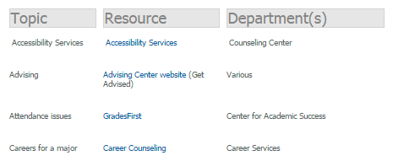
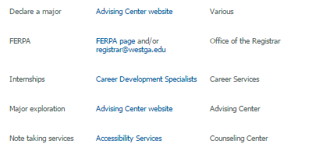
Peaks
Centralize Faculty Advising Resources
Online Portals Curated by Peers Provide Support During Peak Times
Comprehensive Online Toolkit
SSC-Specific Resources Page
Instructions for Accessing SSC
SSC e-Learning Modules
61 Campaign Ideas
Advising Tools — Which to
Use When
Suggested Guidelines for
Using Advising Notes
SSC Advisor Platform Bookmark
A Dozen Common Searches
to Explore
Monthly Tips for Using SSC
Provided by EAB
Adapted from EAB Resources
Created
by IUP
Alphabetical list of topics centralizes disparate resources to help faculty during advising conversations
Removes barriers to accessing and effectively utilizing SSC
\
Notes:
First, let’s address the peaks.
Because of the long gaps between peak advising periods, faculty advisors often feel like they fall out of practice with advising. And when registration kicks in, it’s too late to get up to speed. What faculty really seem to need is a central and organized place where they can find answers and resources, and learn independently on-demand. A faculty resource portal is a simple and seemingly obvious practice – but it’s actually not that common.
If you attended Slippery Rock’s case study presentation yesterday, you heard about their comprehensive faculty CMS, which is also profiled in the Faculty Engagement Toolkit. On this slide we have two other great examples. On the left is University of West Georgia’s comprehensive faculty toolkit. This was created by an ad hoc committee of faculty tasked with finding solutions to lingering campus problems. The toolkit is structured as a alphabetical list of topics or problems that might come up during an advising conversation – with the appropriate resource and the department to contact for more information/refer a student.
Indiana University of Pennsylvania has a similar faculty resource portal, with a page dedicated entirely to SSC. This has effectively removed a lot of barriers to accessing and effectively utilizing SSC. You can see the resources housed on that page here, some provided by EAB, others adapted or created by the AVP for Undergraduate Student Success to be specific to faculty and specific to IUP. Faculty advisors often feel like their resources are hand-me-downs from professional advising. A dedicated resource hub signals to faculty advisors that SSC leaders understand their unique needs.
Again, this is profiled in the toolkit (which is on Box) and the resources themselves are available upon request.

Slide 40

Peaks
Valleys
Proactive Nudge Emails
Lowering Barriers to Engage with Reminders/Resources in Real Time
Nudge emails provide faculty members with an explicit ask or reminder related to proactive advising, along with the resources they need to complete it.
Leadership Prompt Faculty at Key Moments in the Semester
Hi [Faculty Name],
As a retention initiative this semester, I’m asking for your help: please email your advisees listed below who have not registered for spring classes.
This list was generated with the new SSC Platform by looking to see which students are currently enrolled this fall semester and have not registered for any spring classes (and who had less than 106 earned credits).
For your convenience, below is a sample email that you could edit and send.
Thank you for your help in advance for this important retention effort!
Identify outreach or action that would benefit a particular student population
Create a template email for faculty to send to advisees in this population
Use the SSC platform to export the targeted list
Name | Student ID | Email
David Johnson | 345354323 | dj@whitehurst
Jamie Studwell | 097568904 | js@whitehurst
Ryan Grail | 853409852 | rg@whitehurst
Contact faculty asking them to send outreach, providing the template and list
Follow up to discuss outcomes
Notes:
Another strategy you saw profiled in the toolkit, which can be deployed during peak or off-peak advising times, is proactive nudge emails.
These are an effective way of getting faculty to engage by essentially doing the work for them, providing a quick/easy opportunity for even your most discouraged faculty to engage in data-driven advising. In this strategy, SSC leaders, professional advisors, or even faculty champions send nudge emails to faculty members that provide everything they need to send a single round of proactive outreach.
As you see in the timeline on the left, SSC leaders first identify a piece of email outreach that a group of students would benefit from receiving from their faculty advisor. Then, leaders send an email to the faculty advisor including an explicit ask, the list of students to contact, and even a template email. You can see an example on the right, and there are others in the Faculty Engagement Toolkit.
In this way, at a minimum, students receive a proactive message from their advisor at a time when they need it. But SSC leaders that have used this tactic in the past also say it is powerful for showing faculty advisors how simple proactive outreach can be using SSC. If you’ve done any teaching and you’re familiar with the phrase “I do, We do, You do” this strategy is a “We do”. By doing it for them a couple times, and letting them see the results, some faculty will begin to send proactive outreach on their own.

Slide 41




Peaks
Valleys
Nudge Emails at Shippensburg
Program Owner Launches “Just-in-Time Tips” Email Series to Full Campus
Sample Email Calendar
Spring Break
Registration
“New advising tool saves you time to have more meaningful conversations with advisees…”
“How to view midterm grades…”
“How to identify and email students who should be registered but aren’t…”
Week 1
“How to create a work list of your advisees and view other important information…”
“Pilot Faculty’s favorite ways to use SSC vs. how SIS and degree audit should be used…”
Week 16
Key Ingredients
Urgency in Messaging
Clear Action Steps
Behavior Reinforcement
Peer Validation
Frequent emails with timely messaging motivate faculty
to act in real time
Content includes step-by-step guides and links to other detailed resources
Constant reminders reinforce the value SSC brings faculty and students
Featuring quotes from other faculty users validates the utility of SSC
Notes:
What might nudge emails look like if you execute them as a comprehensive strategy?
Shippensburg University did exactly this, with positive results. Shippensburg is another all-faculty advising school in Pennsylvania. The Program Owner, Tracy Schoolcraft, launched a series of “just-in-time tips” or nudge emails to faculty advisors across campus. If you attended their case study presentation yesterday, this slide will look familiar. Each of the 11 circles on the calendar represents the timing of an email that went out across the 16-week semester, with examples highlighted in blue.
Tracy found that four key things contributed to the effectiveness of these emails: urgency in messaging, clear action steps, behavior reinforcement (constant reminders that SSC exists and can be helpful in these ways), and peer validation. We know how important it is for faculty to learn from other faculty, and that real-time validation can go a long way.
This strategy among others helped Shippensburg to achieve high SSC engagement among faculty advisors, comparable to Hamline’s utilization which you saw on a previous slide.

Slide 42
Finances and Preparedness Not Whole Story
Nearly 40% of Completion Delays Relate to Navigating Academic “Product”
Selected Findings from UW-Madison Report: Predictors of Time to Degree (2014)
As Expected, Finances are Biggest Cause of Delays
Students Gravitating to “Delay-Prone” Fields
Many Delays from Unproductive Exploration and “Do-Overs”
Extra Completion Time
Extra Completion Time
Extra Completion Time
Per Stop-Out
17 mo.
STEM
2 mo.
Under-loading
4.5 mo.
Per Part-Time Term
2.6 mo.
Nursing
2 mo.
6 DFW Credits
4 mo.
URM*
0
Engineering
2 mo.
College/School Change
2 mo.
First-Gen*
0
Business
1 mo.
Study Abroad
1.5 mo.
*Being a URM or first-generation student alone does not predict delayed graduation
Double Major
1 mo.
Sources: University of Wisconsin-Madison, Predictors of Time‐to‐Degree for Recent UW‐Madison Undergraduates, December 2014: https://apir.wisc.edu/timetodegree/Predictors_TimetoDegree_2014.pdf; EAB interviews and analysis.

Slide 43







Limits to Advising’s Economics and Efficacy
More Professional Staff Not Enough to Destigmatize Help-Seeking
Never Going to Hire All the Advisors and Staff We Need…
Clear Benefits to Using Peers as Coaches and Mentors
Current Staffing
Ideal Staffing
Retention
Retention gains over similar non-participants
Sense of Belonging
Students with engaged mentors report less feeling of isolation on campuses
Lower DFW, Higher GPA
Course performance gains in sections with course assistants
Not enough funding to make initial investment
Struggle to determine the exact placement of new staff
…And We Miss an Opportunity to Engage Students and Close Trust Gaps
Failing to Deploy Peers Broadly
Disconnected from core academic experiences
Chance to build belongingness among current students plus experiential learning among mentors
Mentorship not leveraged as experiential learning
Source: Kring, Matthew. “Supporting College Students through Peer Mentoring: Serving Immigrant Students.” Metropolitan Universities, 28 no. 3: 102-110.; Kochenour, E.O., D.S. Jolley, J.G. Kaup, D.L. Patrick, K.D. Roach, and L.A. Wenzler. “Supplemental Instruction: An Effective Component of Student Affairs Programming.” Journal of College Student Development, 38 no. 6.; EAB interviews and analysis.; EAB interviews and analysis.
Perceived lack of common experience
Relegated to programs tangential to primary student success efforts
Less able to normalize help-seeking behaviors among hesitant students

Slide 44


Too Little, Too Late
Central Career Services Approach Won’t Be Enough
Innovative Career Office Programming…
Growing Focus on Internship Placement…
Growth in Experiential Learning Requirements…
Advances in technology and new approaches to student and alumni engagement have enhanced the impact of Career Services
Participation, offer, and offer acceptance rates are at decade highs, and internships are now a competitive pre-requisite in many fields
Once a distinctive quirk, more and more universities (even large publics) are requiring hands-on learning experience to graduate
…But Only Reaching a Small Population of Students
Median FTE of 4 staff
~$30k non-personnel operating budget
Up to 1:6,000 student-to-advisor ratio
Only 1/3 offer for-credit career development classes
…But Limited Partner and Support Capacity
Many internships are unpaid and/or non-credit bearing
Not enough employer partners to go around, especially in rural areas
Skepticism about rigor and learning outcomes
…But Merely Another Hurdle Without Broad Investment
Uneven adoption between academic and pre-professional disciplines
Access and time-to-degree concerns for at-risk students
Debates over “what counts” complicate enforcement
Sources: NACE Career Services Benchmark Survey, 2015-16; NACE Internship Survey, 2016; EAB interviews and analysis.

Slide 45
Integrating Academic and Career Development
Strategies to Scale Experiential Learning and Reflection Across the Curriculum
Enhancing the Market Value of the College Experience
How can we help students make more informed choices early in their academic careers?
1
Equip students to proactively align curricular and co-curricular plans with personal goals
How can we ensure that our students can articulate what they’ve learned?
2
Encourage ongoing reflection
and narration
How can we extend skill development opportunities beyond pre-professional majors?
3
Augment the core curriculum to address skill and experience gaps
Scaling Experiential Learning Opportunities to Underserved Populations
How can we create more credit-bearing opportunities for applied learning?
4
Expand faculty engagement with experiential learning
How can we reach students with fewer resources and reduce the risk of co-curricular commitments?
5
Lower access barriers to applied learning outside the classroom

Slide 46


Competency #6: Accountability
Linking Big Goals to Manageable Metrics
Real-Time Process Metrics Are the Key to Hitting Our Audacious Targets
Graduate More
Less Time / Lower Cost
Better Outcomes
First-Year Retention
Sophomore Retention
Transfer Retention
Overall Persistence
Six-Year Graduation
Degrees Conferred
Next-term Enrollment
Student Contacts
Response Rates
Advising Notes
Financial Aid
Registration Holds
Appointments
Big Hairy
Audacious Goals (BHAGs)
Expanded institutional metrics
Real-time process metrics

Slide 47

Not Always That Simple
Difficult for Most Schools to Disentangle the Impact of All Their Initiatives
WSU Doing a Ton on Student Success
General education reform
Warrior VIP Program
Gateway course transformation
EAB mobile app (Guide)
Predictive analytics / alerts
Case management
Financial aid enhancements
Success steering committee
Advisor training academy
Chief diversity officer
Office of Teaching and Learning
Exploratory students program
Undergraduate research
Summer bridge
….and more
But Which Initiative Gets the Credit?
$2.4M
Additional tuition revenue from increased retention
$2.7M
Additional revenue from increased credit hour enrollment
“I can tell you the ROI of all our student success initiatives. But I cannot tell you the ROI of any individual one.”
Monica Brockmeyer, Senior Associate Provost for Student Success
WAYNE STATE UNIVERSITY
Source: EAB interviews and analysis.

Slide 48





Finding the Signal in the Noise
Good Assessments Planned from the Beginning Can Help Pinpoint ROI
Six Steps to Assessing the True Financial Return of Your Initiative
Design your assessment plan before you launch
Track retention directly attributed to initiative
Consider the lifetime value
of the student
Be intentional about the data
you are collecting
Identify a baseline or control group for comparison
Consider cost
and revenues
to estimate ROI
Source: EAB interviews and analysis.

Slide 49





Student Focus Pulled in Multiple Directions
Doubts about Relevance and Practicality Compound Existing Pressures
  Relevance Concerns
  Financial and Life Pressures
  Ability to Give Attention to Courses
  Is this course relevant?
  Study or take a few more hours of work?
  Pressures on Major Choice
  I picked this major because my parents thought it was best
  If I’m already not going to succeed in the major, should I just leave?
  Ability to Access Experiences
  How much would study abroad help me get a job?
  I need to keep working the whole time in college
Source: EAB interviews and analysis.

Slide 50




Four Types of Major on Campus
Tracking Student Flow In and Out of Programs
Donor Majors
Students flow out of these majors more often than they flow in
Example: Computer Science
Static Majors
Students who initially declare this major rarely switch; few students flow in
Example: Nursing
Acceptor Majors
Students flow into this major but few students flow out
Example: Social Work
Pivot Majors
Equal flow of students in and out of the major
Example: English
Source: EAB interviews and analysis.

Slide 51
Visualizing Student Flows Between Majors
Student Major-Switching Analysis
Groupings of Majors from the EAB Student Success Collaborative
N=2,693 majors at 50 institutions; Circle size indicates relative enrollment size
Marketing
Acceptor Majors
Finance
Business
Gender and Women’s Studies
Criminal Studies
Net Receivers of Students
Social Work
Sociology
Economics
Rate of Student Flows In and Out
of Major
Kinesiology
Anthropology
French
Psychology
History
Art
Exercise Science
Nursing
Political Science
English and Journalism
Math and Statistics
Static Majors
Engineering
Pivot Majors
Theater
Dance
Biology
Net Donors of Students
Early Childhood Education
Chemistry
Computer Science
Donor Majors
Music Education
40%
60%
80%
Percentage of Students in a Major
Who Switched into the Major
Source: EAB Student Success Collaborative analysis.

Slide 52





Promoting Continuity in Academic Advising
The Old Thinking
The New Thinking
Advisors assigned based upon institutional structures and departments; often requiring reassignments for major switching
Student movement through the institution dictates advisor caseloads; optimizing consistency despite major switching
Advisor A
Advisor A
Degree Plan
Advisor B
Source: EAB interviews and analysis.

Slide 53



Mapping Student Pathways to Degree
How do students flow in and out of majors at the institution?
Map Historical
Paths to Degree
Categorize Majors by Student Flow Patterns
Assign Advisors to Major Clusters
Analysis of first and last major for 5 years of student records reveals significant student migration across the institution
Four types of major identified based on student flow patterns:
  Donor Majors: Students exit these programs and few enter
  Acceptor: Students enter these majors from other programs
  Pivot: Students equally enter and exit these majors
  Static: Very few students enter or exit
Advisors trained in set of thematically-related majors and a sub-set of common destination majors
Goal: 80% of students remain with the same advisor despite major switching
Of students graduate in 1 of 10 majors
65%
Of students switch majors at least once
Next Steps
75%
Examine requirements for majors in clusters to promote coordinated prerequisites
Source: EAB interviews and analysis.

Slide 54
Enrollment Patterns Offer Re-Organization Blueprint
UTSA Redeploys Academic Advising to Match Student Flow
Life and Health Sciences Cluster
Active Ingredients
Marketing
Mathematics
Students assigned to an advisor based on first major declared
Advisor cross-trained in 10-14 programs of study based on student major switching patterns
Goal is that >80% of students can maintain relationship with 1 advisor despite switching majors
Advisors organized in clusters reporting to a central director who reports to the provost
Special cluster for undeclared students to assist with exploration and placement
Marketing
Communication
Primary Majors
Mathematics
Chemistry
Secondary
Majors
Biochemistry
Public Health
Biology
Kinesiology
Health
Psychology
Management
Interdisciplinary Studies
82%
12
Percent of students will remain with one advisor
Average number of majors an advisor is responsible for
Source: EAB interviews and analysis.

Slide 55






Migrating from Departments to Clusters
UTSA Implementation Timeline
Advising Restructuring Plan announced
Advisors submit top 3 cluster preferences
Confirmed placement of advisors in new structure
Opened new advising office to students
Summer 2013
Summer 2014
Executive Director of Advising appointed
Task forces oversee implementation
Deployed training sessions for all advisors
Implementation Advice
Invite advising staff to participate on taskforces to provide input on future state operations and garner buy-in
Allow advisors to state cluster preferences, but communicate placement will ultimately be dictated by student enrollments
Confer management responsibilities to advising supervisor with central oversight
Source: EAB interviews and analysis.

Slide 56



The Best of Both Worlds?
Major Clusters Allow for Specialization as Well as Consistency
Abilene Christian University
Created Major Clusters as Part of Rapid Advising Overhaul
Examined Major Switching
patterns in Institution Reports
to come up with recommendation
Finalized clusters and assigned caseloads
Small, private Christian university
in Abilene, TX
79% retention,
69% graduation
16 professional advisors and one director centrally housed in new space, “Wildcat Central”
Jan 2017
Aug 2017
16
total clusters
1-10
majors
per cluster
Made the decision to centralize advising and hired new staff
Solicited qualitative input from new advisors, faculty, and deans
~300
students
per cluster
Benefits of Cluster Assignments
Students more likely to keep same advisor all four years, even if they change majors
Advisors able to specialize in one area and develop deep expertise
Advisors work closely with same subset of faculty and build rapport
Source: EAB interviews and analysis.
Notes:
Transition: One way to assign caseloads strategically that allows for specialization as well as consistency is through the use of major clusters.
Abilene Christian University is a small private university in Texas. They underwent a rapid advising overhaul and created “major clusters” to serve as the basis for student caseloads.
In January of this year, they made the decision to centralize advising and hired new staff and transitioned others which gave them a total of 16 professional advisors who would be housed in a new central space. They wanted to minimize students transitioning between advisors, knowing that 70% of students at ACU change their original major declaration.
Inspired in part by the University of Texas at San Antonio’s major clusters, they started by examining Major Switching Patterns in their Institution Reports to come up with a recommendation for how to combine majors together.
I’ll note here that major clusters and meta majors are different: meta majors in an academic context/in the context of guided pathways (designed to shorten time to degree by making courses “count” for multiple programs) whereas major clusters are often designed specifically for advising assignments. GSU assigns advisors based on their academic meta majors, so that’s an option as well.
Across the summer, ACU shopped the recommendation around to faculty, deans, and the newly hired advisors for feedback, and finalized the clusters in time for the fall semester. They ended up with 16 total clusters, with 1-10 majors and approximately 300 students in each. It was critical to them that the clusters be equitable in size.
The benefits of the new model were that students were more likely to keep their advisor all four years, advisors were able to specialize and develop expertise in one area, and advisors work closely with a subset of faculty.
Tamara Long, Dean of Admissions
Bart Herridge, Dean, Student Engagement & Retention

Slide 57
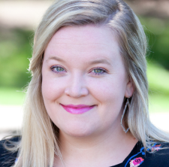
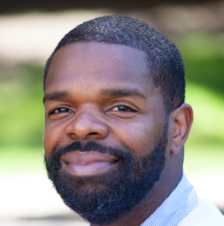
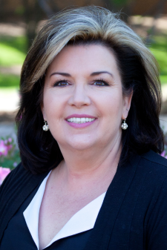

Playing Matchmaker
ACU Solicited Input and Thoughtfully Paired Advisors with Clusters
Four (of 16) Major Clusters
Lindsey: STEM background
Advises:
Biochemistry
Biology
Chemistry
James: Former athletic director and coach
Advises:
Exercise Science
Kinesiology
Nutrition
Sheila: Former communications faculty member passionate about working students in need
Advises:
Bridge Scholars (supplemental support)
Undeclared
Communication Disorders
Janelle: Registered RN
Advises:
Nursing
333 students
300 students
293 students
314 students
Will hire future advising staff into specific clusters
Source: EAB interviews and analysis.
Notes:
Transition: One unique component of what ACU did was solicit input from not only faculty but from advisors during the formation of the clusters. Then, they thoughtfully paired advisors with clusters based on their background and expertise. To illustrate this, here are four actual major clusters (and ACTUAL advisors) at ACU.
Lindsey has a STEM background, and advises Biochemistry, Biology, and Chemistry students. Lindsey helped navigate some tension between the Biology and Chemistry faculty; historically at ACU, these two departments compete for students and the faculty didn’t want to “share” the same advisor. Lindsey, along with leadership, helped convince the faculty that it was in the students’ best interest to be served by the same (qualified) advisor.
James is a former athletic director and high school football coach who works with Exercise Science, Kinesiology, and Nutrition—often athletes with a lot of transition between these majors.
Sheila is a former communications faculty member passionate about working with students in need, so she serves Bridge Scholars and Undeclared students—students in need of a bit more guidance and support. To make the numbers work she also advises students in the Communications Disorders major—a niche program with very little transition in or out.
Nursing happens to be a large major, so that is the one major that Janelle (a Registered RN) advises.
In the future, ACU will match new advisors with the best possible major cluster based on that candidate’s experience and passion.

